Slide 1

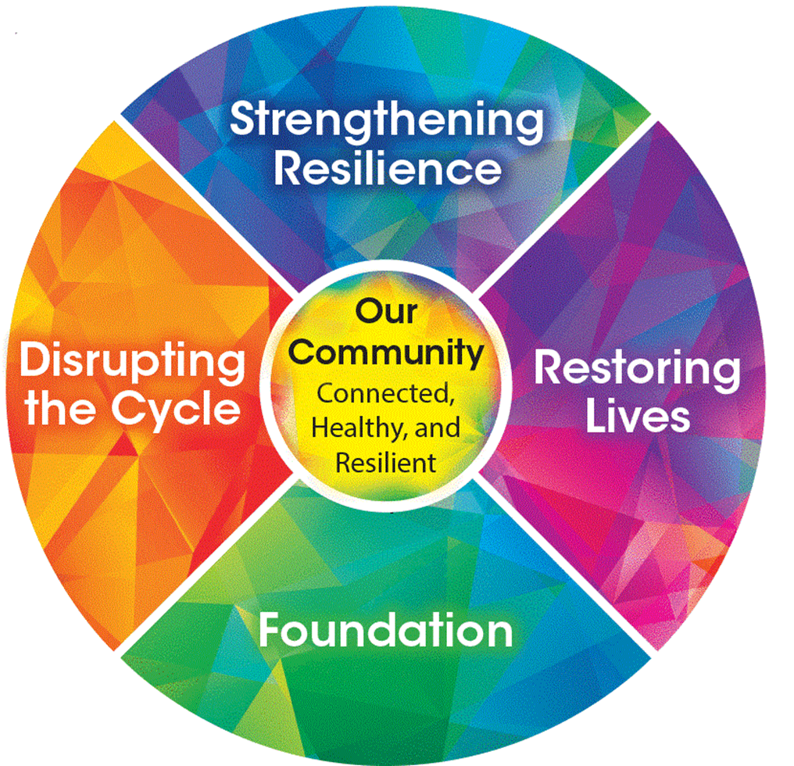
Resilient & Trauma-Informed Community
Trauma-Informed Supervision

Slide 2


Slide 3
Impact of Trauma
Why trauma-informed principles
What it means to be a trauma-informed
- Educating, supporting, managing self and staff
Putting TIC into practice
Agenda
The purpose of this workshop is to provide an overview of trauma-informed principles and values that can be incorporated into supervisory tasks.
Notes:
Set the stage for who we are in the room – people who interact with people and their work.

Slide 4
Who are we today?
In the chat
Name
Organization
Email
Share one thing you hope to learn during our time together?
Notes:
Do this in the chat if a large group (larger than 8-10)
Add a mental health check-in here perhaps? The menti takes time.

Slide 5


Impact of Trauma

Slide 6
What Is Trauma?
There are many ways to describe and categorize trauma.
Ultimately, it is the emotional and physical response to experiencing an event (or witnessing an event) that is dangerous, frightening, or life-threatening.
Notes:
Relias – Page 7 – Handout 2_Different Types of Trauma_TIC Supervision
Trauma can affect different individuals or groups in different ways—two people may be exposed to the same event or series of events, but interpret these events in vastly different ways. Regardless of the severity or type of trauma, the immediate or long-term effects of the trauma can be met with resilience, or the ability to overcome the circumstances and meet new challenges with fortitude.1 Trauma affects different individuals or groups in different ways1:

Slide 7

How Trauma Affects the Mind
Trauma can provoke a wide array of emotional and cognitive reactions.
Trauma can also profoundly shape an individual’s worldview perception of personal safety and interpersonal relationships.

Slide 8
Trauma Impacts Mind
Views about self
Views about world
Views about future
“I feel damaged”
“I’m incompetent”
“The world is a dangerous place”
“It is hopeless”

Slide 9
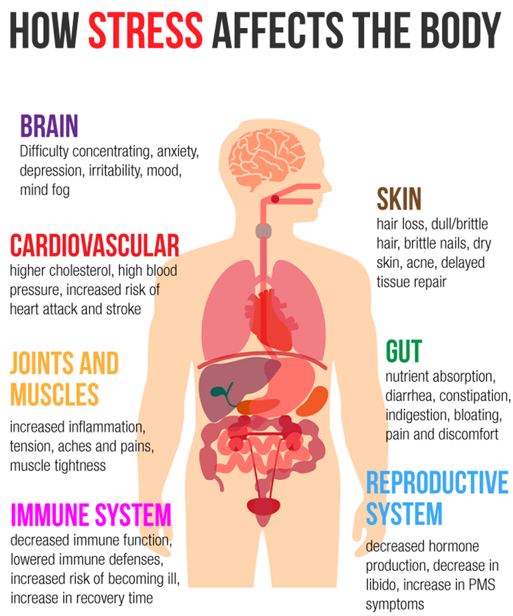
Notes:
Trauma impacts the body: Traumatic events can deeply affect an individual’s physiology, so far as to actually change the chemical makeup of the brain and increase the risk for developing certain physical ailments.

Slide 10
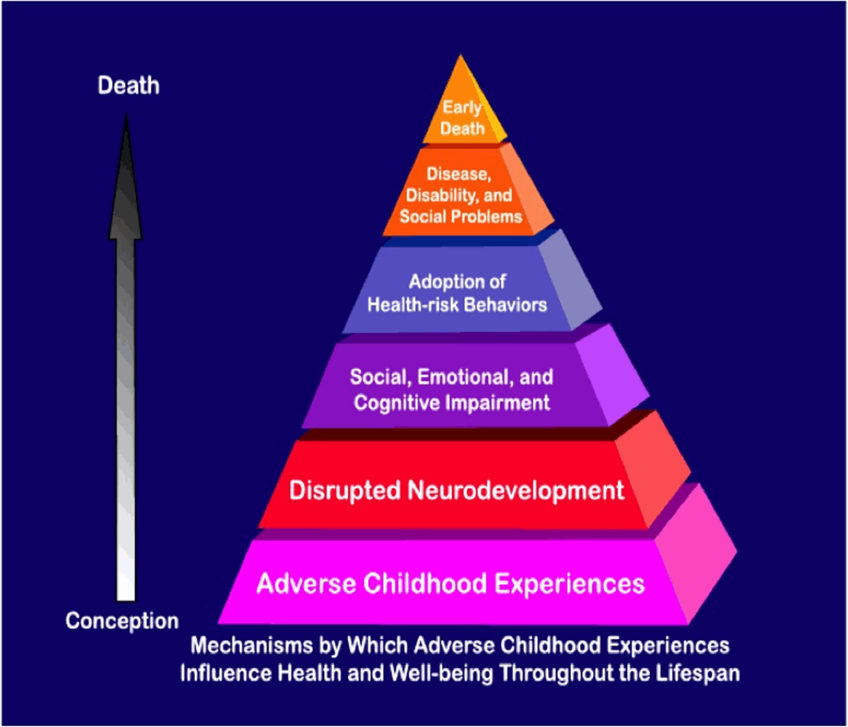
Notes:
Might not need this slide. Just move into secondary trauma

Slide 11
Resilience
But ACEs are not the whole story…
Notes:
ACEs do not have to be a lifelong risk factor for problems. While an ACE score can provide us with an understanding of ‘risk’ level for poor health outcomes, it also has its limitations. It is too easy have narrow vision and only see the impact of trauma in the lives of our (patients, students, employees, clients etc.). An ACE score is not an identity of a child or person. A child or adult who has experienced a high level of adverse childhood experiences can still live a healthy, successful and thriving adult life. An ACE score simply accounts for “did the experience happen”.
While accumulated ACEs do provide us with a marker of risk, an ACE score is limited if we only see trauma. While ACEs may have happened, Resilience was also happening at the same time. [click PPT]
For example, someone may have an ACE score of 8 but they may also have had a safe, stable adult in their life, they experienced healthy social connections through school or faith-based organization, or maybe they did receive helpful supports and interventions at the right time. These are examples protective factors that I am naming and reduce risk for poor outcomes. It is important and recognize the signs and symptoms of ACEs while also accounting for strengths and protective factors that foster resilience. Resilience buffers risk and we can intentionally support the building of resilience.
Recognize the role of trauma, Focus on the Resilience. We cannot change what may have happened, but we can help support the reduction of risk and the promotion of healthy & thriving lives in the people we serve and each other.

Slide 12
A closer look at Secondary Trauma
1) Traumatic Stress
2) Complex Trauma
3) Re-Traumatization
4) Historical Trauma
5) Vicarious or Secondary Trauma
Experiencing trauma-related psychological and physical symptoms in response to helping or empathizing with others who have experienced traumatic events.
This is very common among helping professionals working with trauma survivors.

Slide 13

Why might secondary trauma be common among people in helping professions?
Notes:
Trauma can impact any individual, including those who enter helping professions. For many individuals working
in health and human services, their own history of trauma may have been part of what drew them to help others. But
as was discussed in Section 1 of this document, there are also individuals who may experience traumatic events as an
occupational hazard of their work. For these reasons and more, it is critical that clinicians and other professionals in
health and human services are diligent about assessing their own levels of stressand trauma. It is also necessary that
organizations have in place the resources to support professionals when they experience burnout, compassion fatigue, or
vicarious trauma. – pg 30
In the chat
Possible answers include
Exposure to upsetting stories of personal tragedy
Not enough resources available to fully address the issues(problems)
The work environment
- conflicts amongst team members
Lack of time, skills, heavy work load
Moral and or ethical dilemmas
Continuous exposure to trauma

Slide 14
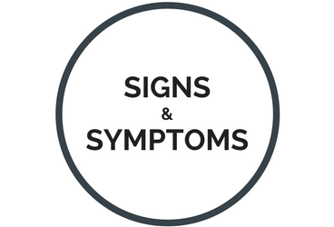
Notes:
Ask for what signs and symptoms may look like, sound like, feel like in the chat?
How Common is Burnout, Compassion Fatigue, and Secondary Traumatic Stress? 50% of mental health professionals report moderate-to-high burnout.
15% of master’s level licensed social workers meet diagnostic criteria for PTSD (twice the rate of the general population).21% of providers treating family or sexual violence survivors experience symptoms of secondary traumatic stress. 34% of child protective workers experience PTSD symptoms due to indirect exposure to traumatic events.47

Slide 15
Difficulty in daily functioning
Physical or psychological reactions to traumatic memories clients have shared
Avoidance behaviors during client interactions
Feeling numb or diminished affect
Some Signs & Symptoms

Slide 16
Difficulty limiting emotional expression
Heightened arousal
Insomnia
Depression
Detaching from family, friends, and other social supports
Some Signs & Symptoms

Slide 17
What is the impact of unaddressed secondary trauma on the organization?
Notes:
Staff Outcomes
Burnout, compassion fatigue, and secondary traumatic stress among staff is correlated with
many negative organizational measures:
• Reduced commitment to the organization
• Negative attitudes toward the organization and persons served
• Absenteeism
• High turnover
• Job dissatisfaction
• Damaged team morale

Slide 18


“The expectation that we can be immersed in suffering and loss daily and not be touched by it is as realistic as expecting to be able to walk through water and not get wet.”
—Rachel Naomi Remen, MD

Slide 19
Why trauma-informed supervision

Slide 20
What are the qualities of a good staff person working under your supervision?
Notes:
Ask participants to list what are the qualities of a good employee in the chat box? Record on slide
After done listing, change title to be ‘What are the qualities of a good supervisor?

Slide 21

Trauma-Informed Supervision
Notes:
Supporting staff, or offering relationship-based supervision, is different from clinical supervision. This supervision model is based on newer ideas about the healing power of relationships. Genuine sharing and empathetic responses sometimes strike supervisors as going against the grain when it comes to what they may have learned about boundaries in school or in their early job training.
This type of supervision model, and trauma-informed care in general, deemphasizes hierarchy and power differentials, and puts self-disclosure and more emotional responses to client/worker sharing in a new light. As a supervisor, your “clients” are the people that you supervise. They can benefit from a supervision model that incorporates many of the same elements as the practice model that you are asking them to implement with the adoption of trauma-informed care. For example, viewing behaviors as coping strategies and symptoms as adaptations when considering how to address issues.
Typical supervisory roles like mentoring, coaching, supporting professional development and building competency in new approaches and best practices can only be enhanced by offering staff support regarding stressors in and outside of work, and by helping them to identify and address emotional exhaustion.
Motivational Interviewing Spirit and Skills
• Collaborative approach • Shared expertise • Reflective listening • Affirming strengths to build confidence

Slide 22

Think of Trauma-Informed Supervision as a framework that shifts the way we think, understand and respond to behaviors and experiences within the workplace.
Notes:
Rather than seeing trauma reactions as pathological, it reframes these reactions as adaptive.

Slide 23
Trauma-Informed Supervision shifts the conversation away from “supervisor knows best” to
“together, we can find solutions.”
Notes:
Each person working within your organization will approach and respond to workplace challenges in a different manner. In a traumainformed
approach, it is critical for supervisors to come alongside individuals. This shifts the conversation away from “supervisor knows best” to
“together, we can find solutions.”1
The impact of TI Supervision within organizations is powerful, and is an approach has shown to be effective in 1) reducing trauma-related symptoms, 2) enhancing relationships, 3) and preventing re-traumatization

Slide 24
Trauma-Informed Supervision starts with trauma-informed perspective shift AND utilizes a skillset of strategies built on new knowledge
Notes:
Each person working within your organization will approach and respond to workplace challenges in a different manner. In a traumainformed
approach, it is critical for supervisors to come alongside individuals. This shifts the conversation away from “supervisor knows best” to
“together, we can find solutions.”1
The impact of TI Supervision within organizations is powerful, and is an approach has shown to be effective in 1) reducing trauma-related symptoms, 2) enhancing relationships, 3) and preventing re-traumatization

Slide 25
Review of
TIC Principles

Slide 26
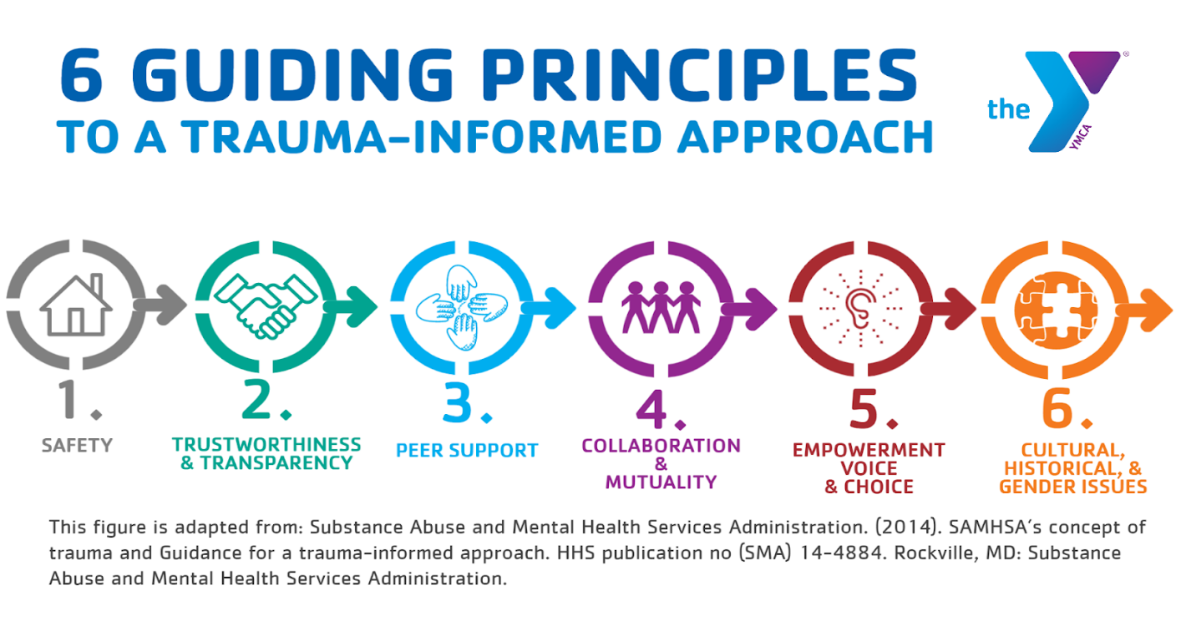

Notes:
Over the next six slides we are going to review the 6 principles of trauma-informed care.
As a personal inventory, think about each question and rate yourself
I have work to do in this area.
I do this, but I’d like to learn more.
I do this and I could teach others.
Group discussion: Summarize that principle and how it plays out in their role and work. (giving examples where appropriate)

Slide 27
Safety:
How can I create a safe space that supports the physical and emotional safety of staff?
How can I develop work agreements that balance both understanding and responsibilities?
How am I establishing a relationship where staff feel safe to share feedback on work experiences?
Notes:
Trauma-informed personal inventory

Slide 28

Trust & Transparency:
As appropriate, how am I sharing information regarding the why and how decisions are being made that may impact my staff?
What am I doing to demonstrate consistency in my approaches and that I am trustworthy?
How am I balancing strength and sensitivity in the way I communicate?

Slide 29
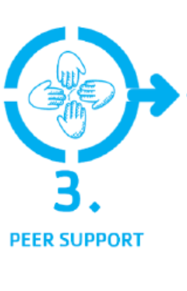
Peer Support:
How am I offering opportunities for staff to learn from each other?
What options do I offer that support a shared sense of team and belongingness?
What opportunities am I taking to share stories that promote recovery, healing and resilience?

Slide 30
Collaboration & Mutuality:
Where am I inviting others to share their input?
What am I do to give opportunity to staff to develop collaborative goals and objectives with me?
How do I work with staff in an engaged way instead of only telling them what to do?

Slide 31
Empowerment, Voice & Choice:
What am I doing to recognize and validate the perspectives and strengths of others?
How do I empower staff to take ownership for the responsibilities of their position?
As appropriate, how am I encouraging staff voice in decisions and offering choices when possible?

Slide 32
Cultural, Historical & Gender Issues:
How does my awareness of historical contexts and power dynamics influence my thoughts, actions and words?
What am I doing to educate myself about the perspectives of staff who have different lived experiences than me?
How am I demonstrating cultural humility and trustworthiness?

Slide 33
Notes:
BREAK after this 10 minutes

Slide 34
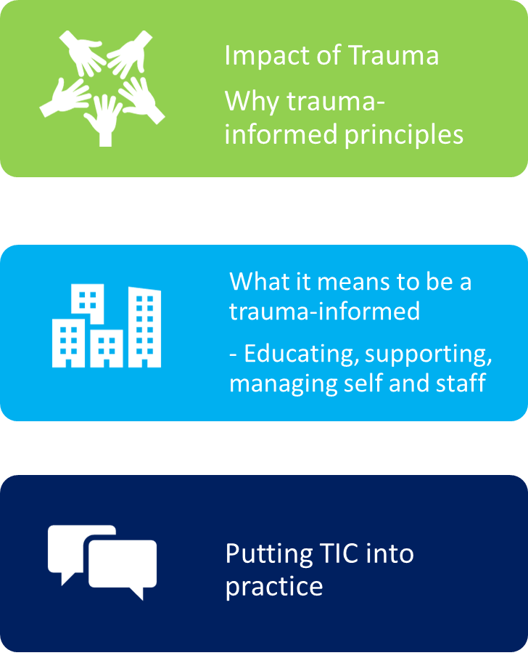

Slide 35






Individual
Actions
Individual
Actions
Organizational Support
Organizational Support
Tools and Resources
Tools and Resources
Notes:
With each area in the framework (education, support, and managing) there are actors or places where that work takes place.
Individuals – this is you and your staff (you mirror each other)
Organizational Support – this is the specific ways in which the organization as a whole – how the organization operates (board, C-suite, funders, etc)
Tools and resources - It’s easy to get overwhelmed with the amount of information out there. Resources are all over (there are MANY)! We will only list a few but give you a guide to go find the ones that fit for you – this is just a starting place.
For example: in education – there are individual actions, there is the organizational support for those actions and then there are the specific tools and resources that deliver what you want to convey.

Slide 36
Educating Self and Staff
Supporting Self and Staff
Managing Self and Staff
ACES Primer
TIC Principles
ProQOL
Window of Tolerance
Menti Mental Health Check-in
Sample TIC Supervisory Session
Staff Feedback
TIC HR
Notes:
Go to resilientcommunitieswi.com/trauma-informed-supervision and look at the resources there.
Investigate a resource or two that interests you the most.
Look at it, find out what you like about it, and when we come back we will have you report on what you liked and how you might use it in your work.
Educating Self and Staff
-ACES Primer - https://www.youtube.com/watch?v=ccKFkcfXx-c
-TIC Principles for the Supervisor -
Supporting Self and Staff
-ProQOL - https://www.dropbox.com/s/cukrsh83j9xqfgb/ProQOL5.pdf?dl=0
-Window of Tolerance https://www.stmichaelshospital.com/pdf/programs/mast/mast-session1.pdf
- How to create a menti
-Self Care Starter Kit - http://socialwork.buffalo.edu/resources/self-care-starter-kit.html
Managing Self and Staff
Sample Supervisory Session - https://www.thenationalcouncil.org/wp-content/uploads/2020/05/TI_SupervisionNote-Template.pdf?daf=375ateTbd56
Staff Feedback Survey - https://www.dropbox.com/s/v6s4lm09pr81l79/Staff-Feedback-Survey.pdf?dl=0
Trauma-Informed HR Practices – example of organizational buy-in - https://www.dropbox.com/s/m7lfhbnu87vga1h/Checklist%20for%20TI%20Human%20Resources.pdf?dl=0

Slide 38
Resources on the Website
www.resilientcommunitieswi.com

