Slide 1
Resilient and Trauma Informed Community Foundation-Building
[DATE]

Slide 2
INSTRUCTIONS FOR FACILITATORS
See notes below
Notes:
SETUP:
Read through the Facilitator’s Guide on Dropbox: https://www.dropbox.com/sh/v6u35s0xzpmk6v9/AADCdUOg3LXPNCbYZhhKCX6La?dl=0
Watch the bonus content on DVD for other relevant content you might want to use.
Test the audio and video before you begin (online or in-person).
Queue up embedded videos (Cleveland Clinic empathy video: https://www.youtube.com/watch?v=cDDWvj_q-o8; Brene Brown: https://www.youtube.com/watch?v=1Evwgu369Jw). Allow any ads to play, then pause at the beginning of the video.
When sharing through Zoom, check the box for “share sound” and “optimize for video clip.”
If online, open the Handouts directory on Dropbox so they can be dragged or uploaded into the chat box quickly (either drag and drop or upload).
Walk through the slides and think about personal anecdotes/learnings that help illustrate points in presentation. Make it relatable to your audience.

Slide 3
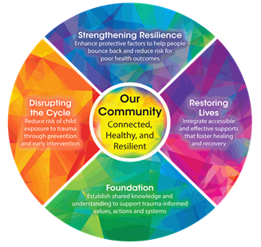
FOUNDATION AGENDA
Resilient and Trauma-Informed Community (RTIC) effort
Film - Resilience: The Biology of Stress and the Science of Hope
BREAK
Foundation of Resilience
Foundation of Empathy
Notes:
Talking points:
Read agenda from slide (revise for your needs)
Script:
This is the agenda for today’s training. We’ll start with an introduction to the RTIC community effort and then we will watch a one-hour documentary called Resilience: The Biology of Stress and the Science of Hope. After the film, we’ll take a short break and then discuss what we learned from the film. Then we will dig a little deeper into the concepts of trauma and resilience and how it affects adult health and life outcomes. Then we will personalize some of these concepts and talk about how developing empathy skills is one of the best ways to build resilience.
As we go along, I will be giving you a few handouts [which I will load into the chat box. You’ll be able to download them there. If you have any trouble getting them, send me a chat or unmute yourself and interrupt me.]
Any questions before we begin?

Slide 4
“Adverse childhood experiences (ACEs) are the single greatest unaddressed public health threat facing our nation today.” - Dr. Robert Block, the former President of the
American Academy of Pediatrics
Notes:
Talking Points:
This quote is why we are here today
It is a call to action for our community
Question: how do we address this public health threat as a community?
Script:
This quote is why we are here today [read quote]. It summarizes why we need to tackle ACEs and trauma as a whole community and why each organization and individual can play a role in changing how we view trauma and toxic stress.
Hearing this quote in the film was one of the catalysts for developing this training. It became a call to action for our community that helps drive the collective work we can do together. As an RTIC network, we see this as a charge to our community, and a motivation both professionally and personally.
Hearing this, the RTIC Support Team asked “how do we do that as a community?” How do we tie together all the great work already being done and inspire more connection among those doing this work? That is the challenge we set out to address.

Slide 5
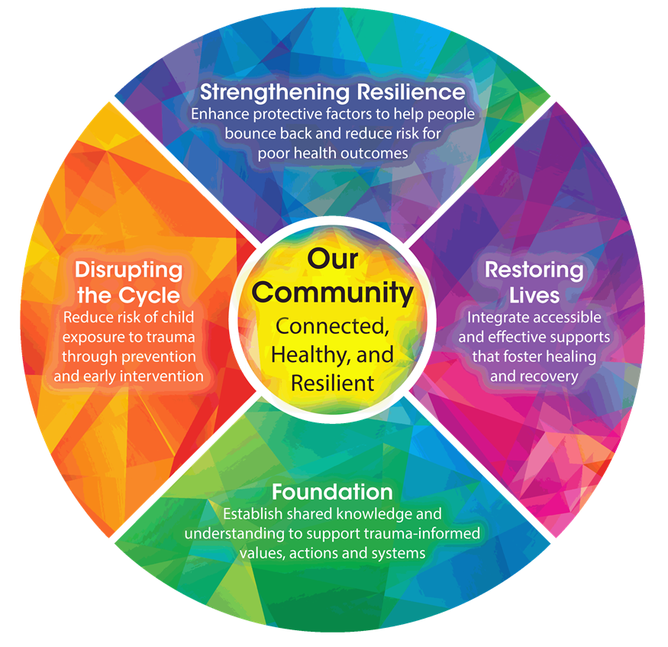
Our Framework: The Kaleidoscope Model of Change
Notes:
Talking Points:
Handout 1
This is our community’s answer to that question.
The Kaleidoscope Model of Change is a framework that connects the work of the community
Goal is in the center
Four segments surrounding it are our Commitments to the community
Begins at the bottom with building a Foundation – common language and understanding
Other three Commitments represent where work is being done in the community
Circular because it is a continuous cycle that repeats itself
Script:
Give out Handout #1 – RTIC Overview
We have a community that is rich with resources, and many people have been doing a lot of work here to become more trauma-informed for about 10 years. The ACEs Study was conducted in 1998, but few people heard anything about it until about 10 years later, and that’s when we started seeing more work being done in our area.
The need to focus on this as a community is what brought together a group of people representing several different community efforts who wanted to learn more from each other about how their work interconnected and how they could be more trauma-informed. Together, they watched the film you’re about to see and felt it could be used to broaden the conversation around childhood trauma and resilience in our community and inspire more connection around this work.
This group, which grew into the RTIC Support Team, saw the wide variety of projects and organizations addressing resilience and trauma and felt there was a need for a framework that could help guide how we all work together to Create a Resilient and Trauma Informed Community (RTIC). We call this the Kaleidoscope Model of Change. The reason for the name is that everyone who picks up a kaleidoscope sees something different every time, though the contents stay the same. Addressing trauma as a community is similar in that how we address it will be unique to each person and organization.
At the center of the framework is our goal: a community that is connected, healthy, resilient, and equitable. Around that goal are four Commitments that this framework makes to the community.
The first, at the bottom, is to build a foundation. That’s why this session is called Foundation training. Here, we are creating shared knowledge and a common language around Adverse Childhood Experiences, trauma-informed care, and building resilience. We’ve trained close to 2000 people in our Foundation-building sessions.
The next three commitments represent the work that is being done in the community, and where more work could be done. Many organizations and projects in this community are engaged in Disrupting the Cycle of trauma, Strengthening Resilience by enhancing protective factors, and Restoring Lives by providing support for those who are healing. You may work in one or more of these three areas, but together, if we are all supportive of each other’s work toward a common goal, we believe we can get to the center.

Slide 6
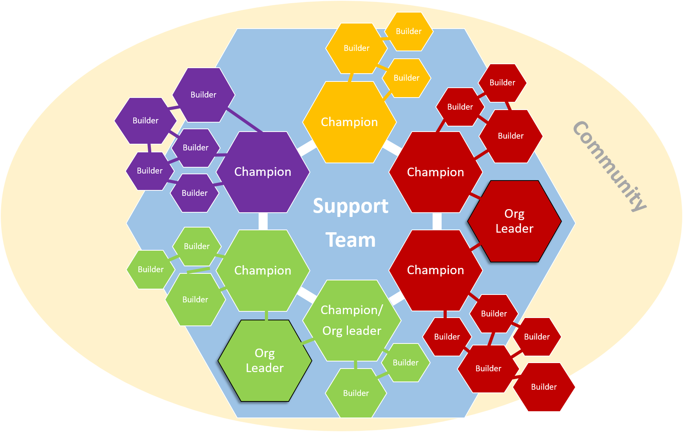
The RTIC Champion Network
Notes:
OPTIONAL SLIDE:
Talking Points:
RTIC functions through a network of Champions like me that represent different organizations involved in this work
In the diagram, each color represents a different kind of organization.
Some Champions are also organizational leaders, and some organizations have more than one Champion.
Even staff who are not Champions can be Resilience Builders, because we all play a role in building resilience
The Champions are connected by a Support Team that plans trainings and brings us together in Communities of Practice.

Slide 7
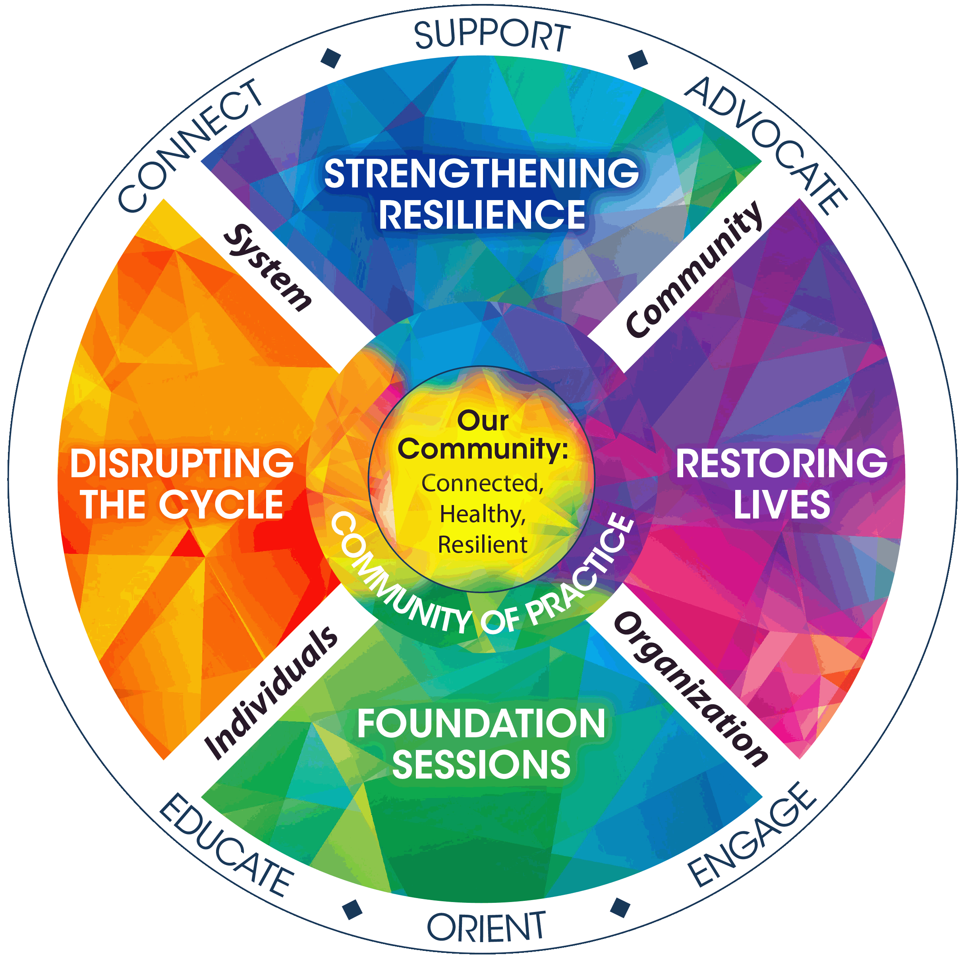
The Role of RTIC Champions
Notes:
OPTIONAL SLIDE:
Talking Points:
This shows the role of the Champions and the Support Team in the RTIC Framework
In the Foundation-building phase, individuals and organizations are engaged, and Champions play the role of educating, orienting, and engaging their organizations.
As we move through the other Commitments, systems and communities become engaged, and Champions play the role of connecting, supporting, and advocating.
Throughout the process of reaching the goal in the center, Champions support each other through a Community of Practice

Slide 8
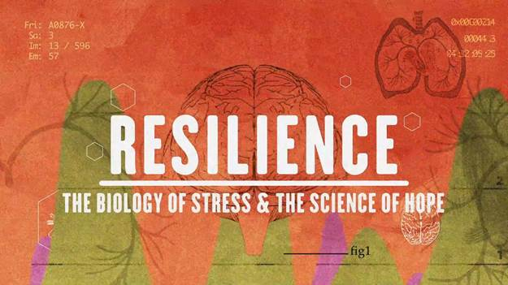
RESILIENCE SCREENING
Content may be upsetting. Please practice self care as needed or ask for assistance.
Notes:
Talking Points:
Film is about an hour
It is not graphic, but discusses trauma, so please practice self-care
We’ll take a short break after it ends
Script:
We’re going to show the film, which lasts about an hour.
As you watch it, look for things that stand out for you or surprise you, and we will talk about those afterwards.
[Online: You can improve the playback by shutting off your video. Please mute yourselves. If there is a major disruption in the broadcast that I may not notice, please send me a note in the chat or unmute yourself and speak out. If needed, we can stop the video and back up to what was missed.]
After the film, we’ll take a 5 minute break.
Just so you know, this film is now available to the public to rent or buy. It’s only a few dollars to rent or buy. You can access it through Google Play Movies, Apple TV, Vudu, or YouTube.
Any questions before the film begins?

Slide 9
5-minute BREAK
Notes:
Let’s take a short break before we continue on. Feel free to turn off your videos. We’ll get started in five minutes.

Slide 10
Resilience review
What stood out to you from the film?
Notes:
Talking Points/Script:
Let’s talk about your first impressions of the film.
What stood out to you?
What ideas were going through your mind?
Did anything surprise you?
OPTIONAL: Break into pair or threes and discuss anything that stood out.
OPTIONAL: Use Table Talk Guide if in person

Slide 11
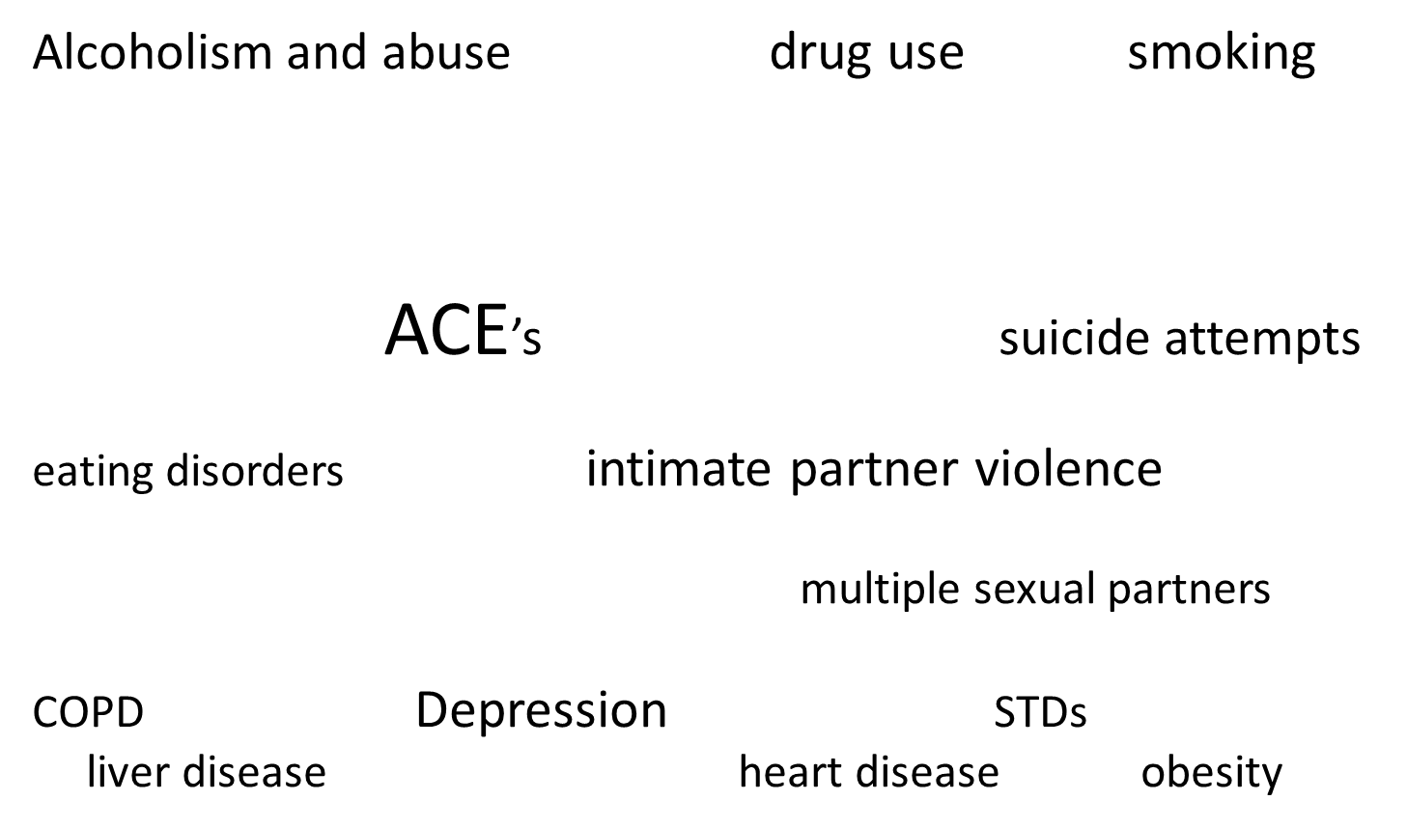
ACE findings. (CDC, 2014)
Notes:
Talking Points:
ACEs can be at the root of many common health and social issues shown here
ACEs are a strong predictor of future health issues
Our community is already doing much work in these areas
Imagine if everyone doing this work were united in working on ACEs as well
Script:
In the film, Laura Porter from Washington state said that if we can get this information flowing through communities, people will create very wise actions. Let’s dig deeper into what information we heard and what it means for our community in determining our actions.
One of the main points in the film is that ACEs are often at the root of dozens of health and well-being outcomes, and that ACEs are common in virtually all populations.
Dr. Burke Harris said, “When you look at ACEs they’re actually a stronger predictor of ischemic heart disease than any of the traditional risk factors...and yet I was never trained on this in one day in Medical School.”
She spoke later of the need to “reduce the dose of adversity” for children as a way of preventing the impacts from trauma. And yet, we also saw that only 5% of the $3 trillion spent on healthcare in our country is spent on prevention.
Think about all the work this community does to directly address all of these more than 40 conditions and disorders that may be rooted in ACEs. How heavily does that work focus on the present situation and treating the outcomes that may have resulted from ACEs? While that work continues, think about what else we could be doing to address a potential root cause of these health outcomes that may not be getting addressed?
We still need good interventions to respond to all of these problems; however, if we apply our knowledge and understanding about ACEs, we have an opportunity to reduce the risk for all of these health and community problems.

Slide 12
Trauma has a ripple effect on a community. So can resilience.
Notes:
Talking Points:
Trauma has a ripple effect through a community, but so does resilience
Each child’s trauma impacts their family dynamics, which impacts the family’s connections with systems, which impacts the culture of a community, including stigma.
Resilience can be built at any level, and it will ripple back from the community to the system to the family to the child
Script:
Another way of looking at this is to think about how the effects of trauma ripple beyond a single child out into the community, and how the community affects that child. In the film, we saw how ACEs affected not just children, but their families, and that the ACEs experienced by a parent when they were a child can continue on in the lives of their own children. This is why we need to understand the context, or environments, in which ACEs occur.
Trauma experienced by a child also impacts the well-being of that child’s whole family and how well the family is able to function. Those families interact with organizations, and with larger systems in the community like county services, healthcare, and schools, and affect their ability to function. When organizations and system struggle to address the trauma of families, these ripples expand and impact the health and well-being of the entire community. Collective traumas, and our reactions to them, help determine our community’s values and culture, and how we treat each other as people.
To be a trauma-informed community, we need to understand how the traumas of children impact all of us collectively, and we need to respond with actions that build resilience. Resilience has a ripple effect as well. If we can build resilience in a child, it can spread into their family. By supporting families, we can see the effect of that resilience in their children, but also in how they interact with organizations and systems, and ultimately improve the health and well-being of our community. This is why we want to learn to recognize trauma, but also focus our actions on building resilience.
As Dr. Shonkoff said in the film, “If we want to produce dramatic impacts on the outcomes for kids experiencing toxic stress, we have to transform the lives of the adults who are taking care of them…We need to do more than give parents information and advice; we need to build their capabilities.”
At the individual level, we can disrupt the cycle of trauma by providing support, by letting people be heard, by understanding one another, by recognizing each other’s dignity. At an organizational level, we can disrupt the cycle through our practices, who we hire, what corporate or organizational culture we promote, through policies and practices that ensure that the people we serve have a voice and that their needs are understood.

Slide 13
Notes:
Talking Points:
ACEs are common and are not specific to a particular population, but the context in which they occur can impact people’s ability to cope with them.
We must understand the underlying context in which ACEs occur, shown here as the roots of the tree.
Adverse Community Environments can exacerbate the impact of ACEs and create more barriers to building resilience.
Script:
Then there are the ways we build resilience at a societal level. This includes having an understanding of the context underlying trauma, and what conditions in our community keep that cycle in place.
This slide portrays the ACEs we learned about in the film as branches on a tree—they are visible and above ground. These are what we see happening in children’s lives, and their effects are felt later in life, in their health and wellbeing as an adult. The bottom half of this slide shows a deeper layer—also called ACEs—Adverse Community Environments. These are not incidents in a child’s life, but are life conditions that surround them. These can be chronic situations that can compound the effects of the ACEs that occur in a child’s life. These adverse environments, such as poverty and discrimination, create more favorable conditions for adversity. As an example, if you are racially diverse in our culture, you are at a higher risk of discrimination than those from the dominant culture, which creates an environment that could exacerbate the effects of any ACEs that you experience in the “above ground” part of this image.
This is why trauma-informed care must be applied with an eye for equity. We can’t just respond to an incident. We need to understand the context in which it occurred and give it the attention it needs. Children who live in more adverse environments may need more complex care.
Keep these adverse community environments in mind along with the ACEs we saw in the film. They provide context to what both children and adults are living with.

Slide 14
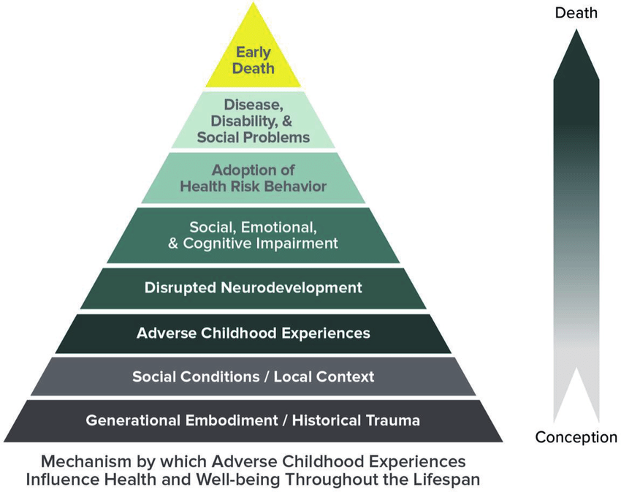
ACEs in Context
ACEs are not limited to 10;
these are just broad categories
ACEs are not an identity
ACEs should not be a source
of shame
ACEs do not have to be
a lifelong risk factor
Notes:
Talking Points:
It’s easy to get caught up in the actual ACE score, and it’s important to understand that there is more to ACEs than the number.
The original ACE study grouped experiences into 10 categories—these are not the only ACEs
ACEs are only part of the picture of what impacts adult health—the diagram from the CDC shows other internal and external factors.
An ACE score simply accounts for whether the experience happened, not what its effect is.
Trauma is subjective—what is traumatic to one person may not be traumatic to others.
ACEs don’t have to be a lifelong risk factor or a source of shame because we can always build resilience.
Script:
In doing that work, we need to remember that we are not just our ACE score.
We heard from Dr. Anda in the film that ACEs are common, and we saw how the adults he spoke to were able to understand their own health and well-being by learning more about their own ACEs. We also heard the recommendation that ACEs be screened by medical providers at the well-child visit.
What we need to remember about the ACE Study is that it wasn’t just about 10 ACEs. The study categorized several hundred types of trauma into 10 categories that became known as ACEs, but these are not the only traumas that affect us in life.
An ACE score can provide us with an understanding of our risk for poor health outcomes, but it also has limitations. While it is easy to focus on that score, an ACE score is not the same as the identity of a child or an adult. A high ACE score is not something to be ashamed of, because even a child who experiences a high level of ACEs can live a healthy and thriving adult life. An ACE score simply accounts for whether the experience happened. They do NOT have to represent a lifelong risk factor. Because…

Slide 15
We are more than our ACE score…
Resilience…
“is not something you’re born with. It’s something that gets built over time.” (Dr. Jack Shonkoff)
can be developed at any stage of the lifetime
creates protective factors that serve a child into adulthood and a buffer against toxic stress
Must be built equitably, with emphasis on those who need it most
can grow from a single positive relationship
Notes:
Talking Points:
Resilience can be built at any time in someone’s life and is a buffer to the effects of ACEs.
Resilience is the introduction of protective factors in someone’s life
Resilience must be built equitably—some people have higher needs than others
A single, positive, stable adult relationship can form the basis of building resilience—this is why we need to develop empathy skills, which we’ll discuss next.
Script:
Although we may have experienced ACEs in our lives, we are also able to build resilience. It is through the development of resilience that risk for poor health outcomes can be reduced.
We heard in the film that resilience is not something you’re born with. It’s something that gets built over time, throughout our lives.
Dr. Shonkoff also said, “We need to put to bed forever the sense that children who are born under disadvantaged circumstances are doomed to poor life outcomes. Science is saying that is not true.”
Reslience must also be built equitably, with the understanding that traumas occur in the context of adverse community environments. We need to consider the context in which we build resilience for individuals and families.
It can begin as simply as a positive relationship. One of the key learnings from the film is that “scientific research points to the presence of a stable, caring adult in a child’s life as the key to building the skills of resilience.”
Before we get into the subject of empathy, does anyone have any questions? Feel free to use the chat or unmute yourself.

Slide 16
5-minute BREAK
Notes:
OPTIONAL BREAK before getting into subject of empathy.
You might ask for questions at this point.

Slide 17
Foundation of Empathy: Accepting our Journey as a Prerequisite to Perspective Shift
We may have held attitudes, beliefs, expectations, or assumptions that were not helpful for others who may have been suffering.
We may have provided care to others that was expected practice but not always trauma informed.
All journeys include missteps…and there will be more
Self-awareness is necessary to building empathy skills. Always aim to self-reflect.
Notes:
Talking Points:
We started by shifting our perspective from “what’s wrong with you” to “what happened to you.”
Up to now, we have focused on the professional perspective, but now we are going to look at our roles as individuals and fellow human beings.
Before talking about empathy, we need to see this as a journey that we have been on and will continue
Review the points on the slide and give personal examples if you are comfortable.
We are all on this journey together, so be kind to yourself and others.
Script:
This is where we personalize the framework and talk about how you as an individual can build resilience by improving your empathy skills.
We mentioned that one of the goals of the Foundation sessions is to encourage a perspective shift towards a different way of thinking about the community around us. One important step to making that shift come more easily is to accept the journey we are all on towards being more trauma-informed.
(review bullet points and give personal examples if helpful, offer examples)
(For all bullet points, note that these statements may STILL be true)
Take-aways:
As we continue our conversations today, keep in mind that this is not a place for shaming or blaming of ourselves or others. If we know better, we will do better. We have all made mistakes or missteps, and we will continue to do so because we will never be perfect. Recognizing this is an important step as we develop our empathy skills.

Slide 18
Empathy is Feeling WITH People…
“Could a greater miracle take place than for us to look through each other’s eyes for an instant”
- Henry David Thoreau
Notes:
VIDEO: Queue up in advance, let ads play
https://www.youtube.com/watch?v=cDDWvj_q-o8&feature=youtu.be
Talking Points:
This video helps show you what empathy looks like.
It is based in healthcare but applies to all areas.
It can be emotional, so please practice self-care.
Discuss afterwards what people experienced.
Script:
This short video helps define what empathy looks like. It helps put it in perspective by showing you examples of the kinds of situations people are in that you may not be aware of.
It was designed specifically for healthcare, but the message really gets across well. It can be quite emotional, so please be prepared for that.
After video: what did you feel when you watched this video? What did you notice?
Facilitators: give any examples of what you noticed. Have you had similar experiences. One example: think about how the woman with the therapy dog, who is celebrating her wedding anniversary, may have to work harder to be empathetic to the family visiting their loved one for the last time. Have others approached situations from very different places like in this situation? Ask for feedback.

Slide 19
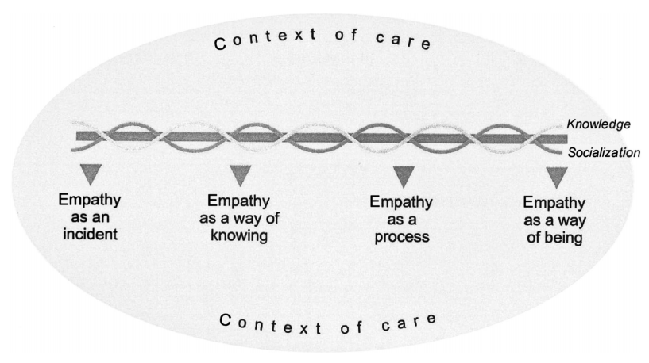
EMPATHY
The goal of empathy is not to solve the problem, but to create connection.
Theresa Wiseman
Notes:
Talking Points:
Share Handout 2
We’ll hear about Theresa Wiseman’s work in the next video: she studied empathy in the nursing profession.
Empathy initially appears to happen in isolated incidents, but as you practice it, it becomes more of the way you are
Being empathetic is a practice. It must be practiced over time to become second nature.
Script:
[Share HANDOUT #2, article by Theresa Wiseman]
Empathy is about creating connection…..about feeling with people. Over 20 years ago, Theresa Wiseman, a nursing scholar, was researching empathy in the field of nursing. Interestingly enough, it was at a time when many in health care were questioning where empathy fits into a field that was predominantly viewed as treatment- or procedure-focused. Her work helps us see empathy as a skill that gets stronger with practice.
At one end of the spectrum, empathy is a single incident in which you use express empathy to others when it is needed. As you get comfortable with this practice, your skill increases, and you become more fluent in the language of empathy. As your skills grow, in time being empathetic is just part of who you are.

Slide 20
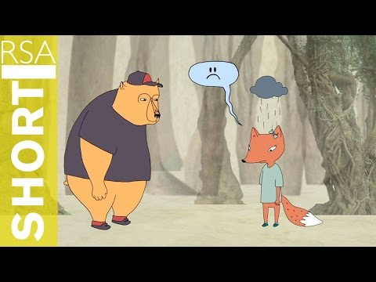
Empathy: Prerequisite to Being Trauma Informed
Notes:
VIDEO: Queue up in advance, let ads play
https://www.youtube.com/watch?v=1Evwgu369Jw
Talking Points:
Brene Brown made this video to describe empathy and sympathy
We’ll have a discussion about this afterwards, so be thinking about examples of empathy as you watch.
Script:
Some of you may have heard of Brene Brown. This video clip is from one of her presentations on how empathy is different from sympathy.
After we watch the video, we’ll ask you to share some stories of empathy in action. We’ll also look at situations where empathy was needed but didn’t happen. As you’re watching the video, try to think of situations you have experienced that you can share.
(With group input, review some of the points made in the video)

Slide 21
Components of Empathy
Perspective-taking
Staying out of judgment
Recognizing the emotion
Communication
From Brene Brown: Empathy vs. Sympathy
Notes:
Talking Points:
Share Handout 3
These are the components of empathy from the video (read each one)
Share an example of empathy (or a time when you or someone was not empathic)
Discussion (use Table Talk Guide in person, consider breakout groups with Handout 4 if a group is large): what examples do you have of
When empathy was expressed well
When empathy was not expressed but could have been
Try to get examples of both
Script:
You heard in the video Brene Brown share these four components of empathy. [Read them.]
Who would like to share an example of a time you experienced empathy in action--or maybe a time when empathy didn’t happen but should have?
BREAKOUT GROUPS: Use Table Talk Guide in person, copy components into chat if online, or put handout #4 into the chat
Sometimes it’s hard to think of what to say in a situation. We’re going to put a handout in the chat that shows some excellent examples of statements you can make when you can’t think of anything else to say. Note that the handout shares statements that may be empathetic in certain situations (such as when a person shares your religious beliefs) but may not be suitable for others. Empathy is about expressing what the other person needs, not what you think should be helpful.
[HANDOUT – Empathetic Statements]

Slide 22
Recognizing Perspective Shifts
Thoughts
Assumptions we make about people
Beliefs about how things should be or what people should do
Feelings
Emotions we feel toward other people
Interactions
How we behave and approach our relationships, work, and life
Thoughts
Interactions
Feelings
Notes:
Talking Points:
We need to recognize our own biases in our thoughts, feelings, and interactions with others.
We are always making assumptions based on our biases.
Trauma is subjective, so we need to recognize that others respond differently.
Script:
Perspective shifting is intentional work. It challenges us to stop and consider our own biases that may act as barriers to serving others with empathy and trauma informed care.
We are always automatically generating assumptions and conclusions about the people and situations we encounter.
Shifting our perspective towards being trauma-informed and resilience-building means raising our awareness of our thoughts, our feelings, and our interactions with others and understanding that each influences the other.
Example….if we believe a person’s situation is their fault, we’re unlikely to feel empathy, and unlikely treat them with empathetic care.
When we examine how we interact with people and practice empathy, we need to remember that every individual is different in how they react to trauma. Trauma is very subjective. What is traumatic to me may not feel traumatic to you.
One helpful observation to keep in mind (shared by practitioner Jim Sporleder) is that “every behavior is a communication.” Try to repeat this to yourself when you see someone behaving in a way that causes you to struggle. What are they communicating? Another quote: “Emotions are not noise, they are data.” What can you do with the data you are gathering? Give examples of recognizing when someone is responding from a place of struggle, and how you might respond with generosity.

Slide 23
Knowing ACEs/trauma
As it relates to knowing ACEs or trauma, what is the prerequisite to being trauma informed?
Knowing what happened…
Knowing something happened…
Starting with generous assumptions about all people we encounter…
Notes:
Talking Points:
When we shift our perspective to “what happened to you?” it’s easy to think we need to know exactly what happened. Question that thinking.
Do we really need to know details? Maybe if we are a physician or therapist, there might be times when we do, but not usually.
(click through to next level of slide) Is it enough to know that something happened? Discuss examples (such as the Handle With Care program)
(click through to next level of slide) We would argue that in most cases, it is sufficient to start with generous assumptions when dealing with other people’s behavior.
Script:
When we work towards being trauma-informed and empathetic, we try to identify with what someone else has experienced. We learn to shift our perspective from “what’s wrong with you” to “what happened to you.”
But do we really need to know what happened to someone in order to be empathetic?
Do we need to know the details of someone’s trauma? (see first bullet) This may be true if we work in a clinical setting and are assisting a patient with a specific trauma, but for most of us, we can connect with a person empathetically without knowing the details of what they are going through.
(Second bullet) What about just knowing that something has happened? Is that enough? Is that necessary? (Give example of Handle With Care—where law enforcement agencies will notify a school district if a student was involved in an incident, but not offer any details of the incident, only their name) This may be helpful in dealing with specific situations, but is it always necessary?
(Third bullet) For most of us, in most situations, we can be more empathetic simply by starting with generous assumptions. We can’t always know what drives people’s actions. Think about situations when you may have made the wrong assumption about why someone behaved the way they did. Imagine how that might have gone differently if your assumptions were more generous.
Empathy is not about taking others’ actions at face value. It’s about being generous in our assumptions about the intention behind those actions.
Discuss examples.

Slide 24
Group Talk: Sharing Your Shifts
Do you have a story of your perspective shift?
If I knew then what I know now…
What was one of your a-ha moments?
What would you tell your younger self?
Notes:
Talking Points:
We’ve all experienced perspective shifts when dealing with other people. Let’s discuss some of those.
Group activity (online breakouts or using Table Talk Guide in person):
Review questions on slide to prompt discussion
Share your own examples
Script:
Now we are going to have a group discussion to go into more detail.
Many of you have experienced a situation that caused you to think differently about your interactions with, or feelings towards, other people.
Would anyone be comfortable sharing a story about how your perspective was changed. If you don’t have a story, think about who you were and how you acted or thought when you were younger, and what you do differently now. Perhaps you’ve had experience with trauma—either your own or someone else’s—and it has helped you see things differently in life.
Would anyone like to share something?

Slide 25
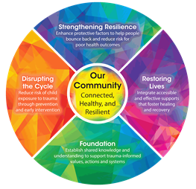
Putting Shifts into Practice
Take notice of your use of empathy...and missed opportunities.
Take notice of changes to thoughts, feelings, and interactions.
Share stories of Trauma Informed Care.
Listen for and recognize shifts in others.
Notes:
Talking Points:
We’ve focused on shifting your perspective toward practicing empathy.
As you go forward, keep developing your practice, using these tips on the slide
We hope you’ve gained some new insights from today’s session
Script:
Develop this into a practice
Today we have tried to give you a chance to look at yourself and others in a new light, one that takes into account all the experiences that make up a person.
As you go forward from today, try to use these skills to notice things you may have missed in the past. Watch for ways that showing someone empathy can change a situation from negative to positive, and see what happens as a result. Listen to the way you and others talk about people, and try to identify new ways to think about the people around you.
We hope you’ve learned some important skills today and will continually find new ways to put them into action

Slide 26
Resources for RTIC Organizations
Online (available to everyone):
RTIC website: www.resilientcommunitieswi.com
Foundation training schedule
Videos and articles on resilience and organizational change
Organizational Assessment
Paper Tigers film (school case study): free on Vudu, Amazon
Resilience film (streaming): $2 rent/$8 purchase on Vudu, Google Play Movies, Apple TV, YouTube
Better Together website: www.bettertogetherlacrosse.org
Dinner Table Resilience videos/sheets
Resources for Champions:
DVD bonus content (see Support Team to borrow DVD)
Video list, articles, primers on resilience, ACEs, trauma-informed care, and RTIC on Champion Dropbox folder
Notes:
Talking Points:
Here are some resources from the RTIC Network
As a Champion, I can help all of us access some of their other resources on our shared drive
Script:
As a Champion in the RTIC Network representing our organization, I have access to RTIC resources that we can access together.
Here are some other resources online that you can access yourself.
Please talk with me about what other resources would be helpful, and I will help you access them.

