Slide 1
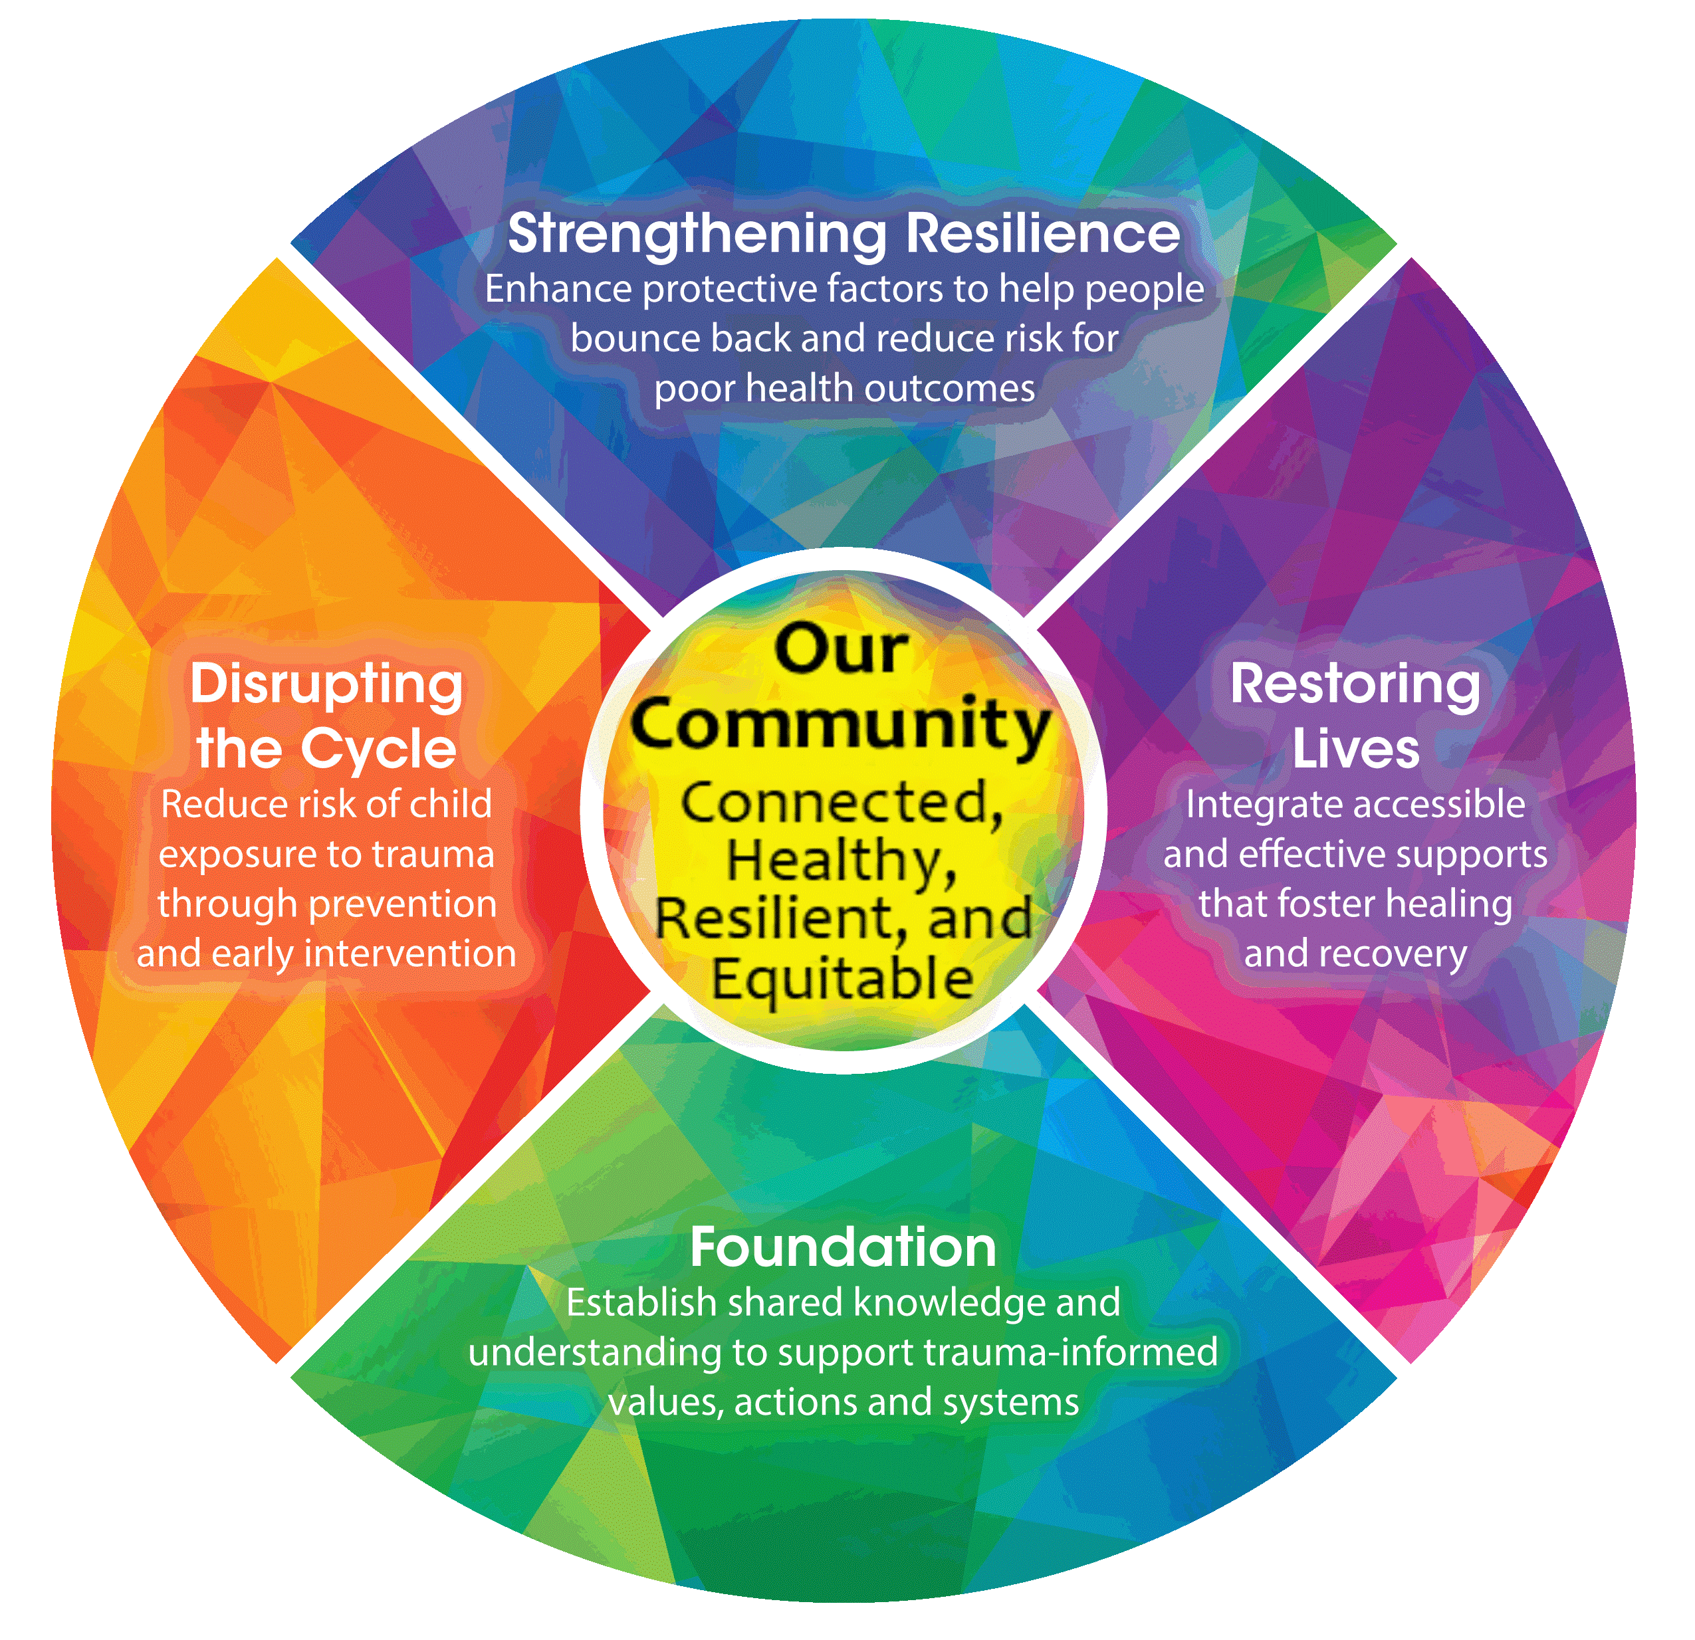
Building a Foundation
Creating a Resilient and Trauma-Informed Community
(RTIC)
[Date]
Notes:
Welcome! We’re here to talk about creating a Resilient and Trauma-Informed Community and the work we are doing in La Crosse. This is our Foundation training. We’ll be hearing a lot more about this diagram as we get into the topic more.

Slide 2
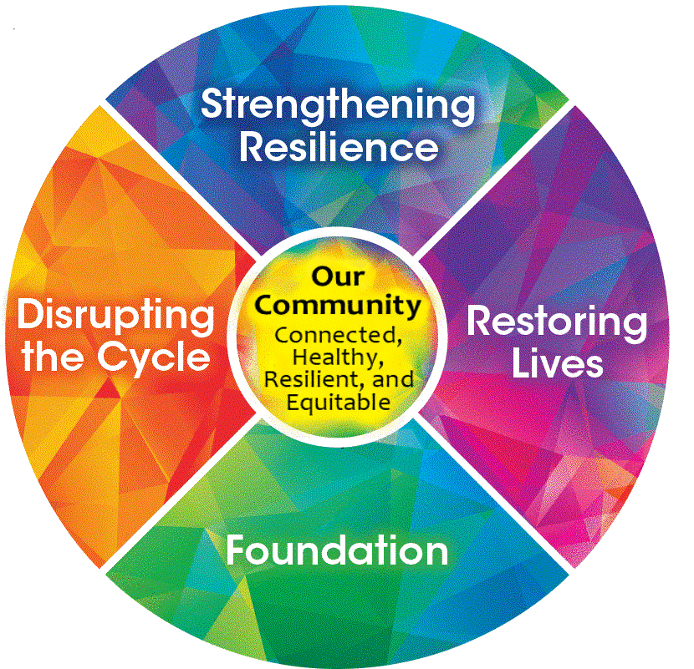
RTIC FOUNDATION AGENDA
Film: Resilience: The Biology of Stress and the Science of Hope (2016)
Adverse Childhood Experiences (ACEs)
The Science of Stress and Resilience
BREAK
Perspective Shifts and Empathy
Tools for Building Resilience
RTIC in the Community
Notes:
Talking points:
Read agenda from slide (revise for your needs)
The film will be in segments: ACEs, toxic stress, resilience, etc.
Break
Applying learnings to personal and professional lives
What La Crosse community is doing
Script:
Here is the agenda for today’s training.
Today’s session is rooted in a film that provides an excellent starting point for talking about trauma and resilience. It’s called Resilience: The Biology of Stress and the Science of Hope, and we’ll be watching it in segments as we go through today’s session.
We’ll begin with an overview of Adverse Childhood Experiences, or ACEs, and hear about the original ACE study from 1998. Then we’ll go into more detail about how ACEs interact with stress, and how resilience can play a role in offsetting the negative impacts of ACEs and toxic stress.
After a break, we’ll look more closely at some tools that help us take an approach that is trauma-informed and that builds resilience. This includes building empathy skills.
Finally, we will describe what the La Crosse community is doing collectively to counteract the effects of ACEs and to build a foundation for a more resilient and trauma-informed community, or RTIC. Today’s training is the first step of building that foundation.

Slide 3
“Adverse Childhood Experiences (ACEs) are the single greatest unaddressed public health threat facing our nation today.”
- Dr. Robert Block, the former President of the
American Academy of Pediatrics
Notes:
Talking Points:
This quote is why we are here today
It is a call to action for communities
Goal is 1) a sense of hope that resilience can be built and 2) a sense that participants have the skills to build resilience and become more trauma-informed
Script:
This quote is why we are here today [read quote]. We're going to hear a lot more about this idea when we learn about the original ACE study.
This is a powerful statement, and it summarizes why communities need to tackle ACEs and trauma collectively. Each organization and individual in a community can play a significant role, even with small actions, but it takes a whole community to address trauma and toxic stress, and to build resilience, on a larger scale.
Hearing this quote in the film we’re about to watch was one of the catalysts for La Crosse to develop this RTIC, or Resilient and Trauma Informed Community, effort, and particularly this Foundation training. We’ll review this community work in more detail later, but this kaleidoscope image that you will see throughout the slides illustrates the framework at the root of La Crosse’s work.
Resilience work can be empowering and hopeful. Our goal for today is that you will come away from this training with two things—a sense of hope that resilience can be built in yourselves and others, and a sense that you already have the skills to do so and to become more trauma-informed. It may just take some practice.

Slide 4
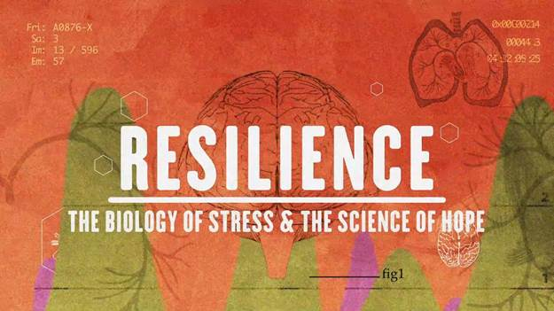
Note: This film talks about childhood traumas but is not graphic. Please practice self-care.
Notes:
Chapter 1, 2, 3, – ACE Study and correlations
Timestamp: 00:00-10:00
(Cue to end streaming: Look for statistic, “Of the $3 trillion spent on healthcare, only 5% was spent on preventive medicine”)
Script:
We’re now going to watch the first few chapters of the film, which discusses the original 1998 ACE Study and how ACEs impact people’s lives. After the film, we’ll reflect on what we saw, so watch for things that stand out for you or surprise you.
Just a note: the film is not graphic, but it does list specific types of traumas experienced by children, so please practice self-care and take breaks if needed.

Slide 5
Reflection
Notes:
Script:
What stood out to you? Did anything surprise you?
Table Talk 1 (use handouts if desired): “Talk at your tables/groups about what stood out to you or surprised you in this segment of the film.”
Report out from tables if desired.

Slide 6
Avoiding misconceptions about ACEs
There are not just 10 ACEs.
Trauma is subjective to the individual.
An ACE score is simply a record of what happened.
An ACE score can be a starting point for healing.
The impact of ACEs doesn’t have be lifelong; we can always build resilience.
Notes:
Talking Points:
Read through the bullet points on the slide
Script:
The film gave a broad introduction to ACEs, but let’s look more deeply at what they are and what they are not, because there are several misconceptions about them.
An ACE score totals up the types of traumatic experiences a person has had, ranging from 1 to 10. It’s important to realize, however, that there are not just 10 ACEs. The original ACE study was limited to 10 categories of adverse experiences in order to show that there is a correlation between the dose of trauma and the health and life outcomes that may result. That correlation is based on dozens of individual adverse experiences.
There are adverse experiences beyond the original 10 categories that may be traumatic. The word “trauma” is subjective—what is traumatic for one person may not seem traumatic to another. The important takeaway is that a high dosage of adversity has the potential to increase the likelihood of negative health outcomes later in life.
We are not defined by our ACE scores. An ACE score is simply a record of what has happened to us, not a measure of how it affects us. It doesn’t take into account what we do to offset or address ACEs that may have occurred. This is where resilience comes in.
Knowing our ACE score can be a place to start our healing process. We heard from Dr. Anda in the film that ACEs are very common, even high ACE scores. Later in the film, we will see how adults who learn their scores gain a better understanding of their own potential for health and well-being. It’s also important to point out that your ACE score is yours alone and doesn’t have to shared with others. You don’t need to know another person’s score to be empathetic to them. We’ll get into this more later.

Slide 7
Notes:
Chapter 4, 5, 6 (partial) – Brain science, overactivation, Shonkoff toxic stress
Timestamp: 10:01-22:22
(Cue to end streaming: Look for children playing soccer outside and listen for Dr. Shonkoff’s comment about ‘suck it up’)
Script:
Now we are going to return to the film and learn more about how the environment people live in affects how ACEs impact their lives. We’ll also learn about the science of how ACEs affect the body.

Slide 8
Reflection
Notes:
Script:
What were some of your takeaways from this segment of the film? Did anything surprise you?

Slide 9
Credit: PACEs Connection: https://www.pacesconnection.com/blog/3-realms-of-aces-updated
Notes:
Talking Points:
ACEs don’t exist in a vacuum. They are affected by context.
Negative conditions make it harder to reduce the impact of ACEs.
Positive conditions can serve as a buffer to the impact of ACEs.
Conditions outside the community, such as natural disasters, can impact the ability of communities and policy makers to buffer ACEs.
ACEs impact all populations, but some experience more than others and have fewer buffers available to them, so we need to consider equity in resilience-building efforts.
Script:
This is a very busy slide, so this is also available as a handout. [Handout #1]
As Dr. Harris noted in the film, simply the place where you live can influence your health and even your life expectancy. We can’t look at ACEs in a vacuum. We have to consider how they occur in the context, or environment, of children’s lives.
We are going to talk a lot today about how a single person can have a huge impact on a child’s life. If one person can change the course of a child’s life, and even their health, imagine how big an impact the rest of their environment can have. Context matters, especially early in life.
It’s not just which ACEs we experience, but the conditions in which ACEs occur that affect our future health. This image represents Adverse Childhood Experiences as growing on a tree. These are direct experiences that can have serious impacts if there is no buffer against them. But these experiences on the tree are fed from underneath by conditions in the surrounding community. These have indirect effects on the child and possibly their family and other people in their lives.
What we need to remember is that if the tree were growing in healthy soil, or a more healthy and supportive environment, that environment would serve as a buffer to the impact ACEs might have.
There are many ways to depict this, and this image goes a step farther by introducing a third layer of context—the environment beyond the community level. This layer of context affects the broader population and includes external forces like natural disasters and health emergencies like pandemics. These are all stressors that not only impact individual children coping with ACEs, but with their communities, the people who may be helping or treating them, and those who set policies that affect them more broadly. Think about a child experiencing ACEs in 2019 vs. during the COVID-19 pandemic and the resources available to them.
This is not to say that ACEs only occur in certain populations or conditions. ACEs are very common in all populations; it is access to resources that is not equally distributed. ACEs can happen to anyone, but access to care and to resilience-building buffers may be heavily influenced by the world in which a person lives. This is important to remember for ourselves and those we interact with so that our efforts to build resilience keep a focus on equity.

Slide 10
Importance of Equity
Credit: Robert Wood Johnson Foundation
Picture Link: https://betterbikeshare.org/wp-content/uploads/2019/10/pasted-image-0.png
Notes:
Talking Points:
We can build resilience through providing buffers that match the needs of a person which is empathy
Equality is where everyone is given the same resources
Equity is where everyone is given resources that match their specific needs
ACEs are an example where some populations need more help than others to build resilience
Script:
So what do we mean by equity?
When it comes to building resilience equitably, we mean providing buffers and support that match the needs of a person, regardless of how that compares to the needs of others. Equity is not the same as equality.
This slide illustrates what equitable support looks like.
“Equality” occurs when everyone is given the same resources or opportunities, regardless of their needs. It ignores context. Each of these people needs a bike, but a standard bike doesn’t meet the needs of each person equally. An equal approach—giving everyone a standard bike, or generic supports—may feel good, and may meet the needs of most people, but it doesn’t take into account the different contexts in which we all live. A solution that doesn’t work within our individual contexts may not be a solution at all, and in fact could be a waste of resources.
“Equity” recognizes that each person needs different resources to reach the same outcome as others. Equity considers the context, history, and conditions surrounding each person. In the image, each person receives the bike that suits their needs, but the bikes are not all the same.
We need to commit to processes and practices that fight for equitable services and treatment for victims of ACEs and trauma.

Slide 11
Trauma can ripple through a community.
But so can resilience.
Notes:
Talking Points:
It takes a community to tackle public health issues like ACEs, but there is still a role for individuals
When a child experiences ACEs, it can ripple out to affect others in the community
We can find hope because resilience works in the same way
Building our own resilience helps us interact with others and in turn helps build their resilience
We do this with empathy
Script:
We’ve mentioned how it takes a community to tackle such a large public health issue as ACEs and toxic stress, but that there is also a role for individuals, whether we are acting in professional roles or just as members of the community.
When a child experiences ACEs, the impact doesn’t end with that child. It ripples out through their interactions with those around them, who themselves may have been impacted by their own adverse experiences or stressors. Through interactions and relationships with friends, neighbors, care and service providers, employees and coworkers, and the community at large, the damaging and compounding effects of adverse experiences can ripple outward. At a large scale, because they are so prevalent, these events can impact how community members view and relate to each other, leading to stigma, judgment, and discrimination in our culture.
Where we find hope is in the fact that resilience-building works much the same way. As Dr. Shonkoff said in the film, “If we want to produce dramatic impacts on the outcomes for kids experiencing toxic stress, we have to transform the lives of the adults who are taking care of them…We need to do more than give parents information and advice; we need to build their capabilities.”
By building our own resilience and recognizing how we interact with and respond to others, we can find ways to build each others’ resilience. We can create buffers against the rippling effect of ACEs and trauma through our communities. Through supportive interactions and relationships, whether as professionals or just as members of a community, we can play a role in meeting people’s specific needs and interrupting the flow of trauma wherever we are able. The more people who learn to do this, who focus on building resilience, the bigger the effect we can have on reducing stigma and changing how we treat each other as people.

Slide 12
Resilience:
The ability to thrive, adapt, and cope despite tough and stressful times.
Notes:
Talking Points:
Read the definition of resilience on the slide
When watching the film, think about how the environment affects our ability to build resilience
Script:
Before we return to the film, let’s talk about this term “resilience.” What does it mean? Resilience is the ability to thrive, adapt, and cope despite tough and stressful times. In the next block of the film, we will see examples of how resilience works to buffer the effects of ACEs.
While watching, think about how resilience has impacted your life and the experiences you have had. Notice how the environment—both the physical environment and just the people around us—affects our ability to build resilience.

Slide 13
Notes:
Chapters 6 (partial), 7, 8, 9, 10, 11 – Case studies: Clifford Beers, Counselor story, Miss Kendra
Timestamp: 22:23-42:51
(Cue to end streaming: Look for school bus driving away)
Talking Point:
The case studies in the film show what resilience-building looks like in practice.
Watch for examples of resilience being built.
Script:
In this segment of the film, we’ll see some case studies of how resilience is built. While watching, think about how resilience has impacted your life and the experiences you have had. Notice how the environment—both the physical environment and just the people around us—affects our ability to build resilience.

Slide 14
Notes:
We’re going to take a short break, but before we do, we have an assignment for you.
Dr. Shonkoff introduced the concept of resilience as a buffer to the impacts of childhood trauma, especially if there is the presence of a stable, caring adult in a child’s life. During the break, take a moment to think about a person in your life who always believed in you or who supported you in your childhood or your youth, regardless of the circumstances. We’ll ask a few of you, if you are comfortable, to share your stories when we come back.
Let’s take a 10-minute break before we continue.

Slide 15
Reflection
Notes:
Script:
We asked you to think during the break about a stable, caring adult in your life. If you are comfortable talking about this person’s impact, take a few minutes to share your story with the people at your table.
***Let groups talk 2-3 minutes.***
Would anyone like to share their own story (please don’t share others’)?
For everyone:
Do you see how this person’s presence in your life built your resilience? Can you see how they acted as a buffer against adverse experiences you may have had?
Do you see ways that you could be a supportive, caring adult in another child’s life? Do you see how you build the resilience of another person?
Going back to the film, what stood out to you in these case studies? Did you see examples of resilience being built?

Slide 16
Empathy Video
“Empathy: The Human Connection to Patient Care” (The Cleveland Clinic)
-or-
“Perspectacles” (Houston Kraft) – empathy in an educational setting
Notes:
VIDEO: Queue up in advance, let ads play
https://www.youtube.com/watch?v=cDDWvj_q-o8&feature=youtu.be
Talking Points:
This video helps show you what empathy looks like.
It is based in healthcare but applies to all areas.
It can be emotional, so please practice self-care.
Discuss afterwards what people experienced.
Script:
One of the keys to building resilience is practicing empathy. So what do we mean by empathy? Empathy is a skill that you already have, and it can be learned and developed. It is an awareness of others that goes beyond what people say. It is a way of creating connection and understanding. All of this helps you build resilience for yourself and for the people around you.
This short video helps you see what that awareness looks like. It helps shift our perspective by giving us a glimpse of what others might be experiencing that may not be obvious to us. Empathy is the skill that helps us recognize what is not obvious.
As you are watching it, think about situations where you may not have realized what was going on in another person’s world when you interacted with them, and how different that interaction might have been if you had been more attuned to their situation.
[Option 1: Empathy video] This film was designed specifically for healthcare, but the message easily translates to other areas. Just a warning: it can be emotional for some, so please be prepared for that and practice self-care however you need to.
[Option 2: Perspectacles video] This clip takes place in an education setting among students, but you can easily translate that to other area. Just a warning: it can be emotional for some, so please be prepared for that and practice self-care however you need to.
[After video]
What did you feel when you watched this video? What did you notice?
Thinking back to the film segment we just watched, can you think of examples of empathy being practiced?
[Facilitators: give any examples of what you noticed. Have you had similar experiences. One example: think about how the woman with the therapy dog, who is celebrating her wedding anniversary, may have to work harder to be empathetic to the family visiting their loved one for the last time. Have others approached situations from very different places like in this situation? Ask for feedback.]

Slide 17
Prerequisites to empathy
We may have held attitudes, beliefs, expectations, or assumptions that were not helpful for others who may have been suffering.
We may have provided care to others that was expected practice but not always trauma informed.
All journeys include missteps…and there will be more.
Self-awareness is necessary to building empathy skills. Always aim to self-reflect.
Notes:
Talking Points:
We started by shifting our perspective from “what’s wrong with you” to “what happened to you.”
Up to now, we have focused on the professional perspective, but now we are going to look at our roles as individuals and fellow human beings.
Before talking about empathy, we need to see this as a journey that we have been on and will continue
Review the points on the slide and give personal examples if you are comfortable.
We are all on this journey together, so be kind to yourself and others.
Script:
In order to develop our empathy skills, we need to acknowledge a few things before going farther. Being empathetic means changing the way we interact with others, and with ourselves. We need to be willing to look at ourselves more closely and recognize where we’ve been up to this point and who we are now before we focus on growing and doing better.
[review bullet points and give examples if helpful, especially personal examples]
(For all bullet points, note that these statements may STILL be true in the present, even though they are written in past tense)
Take-aways:
As we continue our conversations today, keep in mind that this is not a place for shaming or blaming of ourselves or others. If we know better, we will do better.

Slide 18
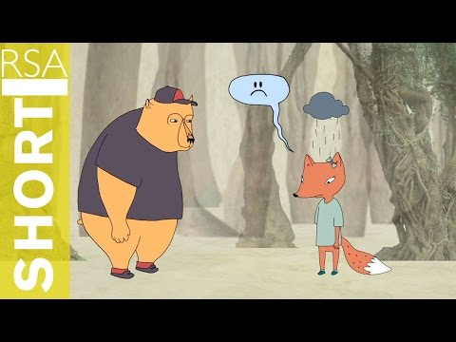
Empathy: Prerequisite to Being Trauma Informed
Video Link: https://www.youtube.com/watch?v=1Evwgu369Jw
Notes:
VIDEO: Queue up in advance, let ads play
https://www.youtube.com/watch?v=1Evwgu369Jw
Talking Points:
Brene Brown made this video to describe empathy and sympathy
We’ll have a discussion about this afterwards, so be thinking about examples of empathy as you watch.
Script:
Some of you may have heard of Brene Brown, and this is one of her clips. When most people first learn about empathy, what they are really thinking of is sympathy, and it’s important to know the difference. This video clip talks specifically about how the two differ.
As we watch the video, think about situations you may have been in where empathy was expressed well, either by you or someone interacting with you, but also about situations where empathy could have been expressed better. Sometimes empathy failures are easier to think of. We’ll share a few stories afterwards.
(With group input, review some of the points made in the video)

Slide 19
Notes:
Chapters 12, 13, 14, 15 – Solutions/Tools/Trauma-Informed Care: Washington
Timestamp: 42:52-credits
Script:
We will now finish up the film. This is where we start talking about actions that we can take as individuals as well as communities. As you watch it, look for actions that you could take to build your own or someone else’s resilience.

Slide 20
Resilience Reflection
Well Child Visit
Home visits
Mindfulness
Meditation
Sleep
Nutrition
Therapy
ACEs Education
Notes:
Talking Points:
Moving on to "what can we do about this?"
Majority on the list are things we can do on our own or encourage others to do
ACEs are among us- everyone has a role in building resilience
Can you see how you can build resilience and prevent ACEs from occurring?
Script:
So we heard about several suggested actions that answer the question of “what can we do about this?”
Review slide. With the exception of the well-child visit and perhaps therapy, all of these occur outside of medicine. These are things we can do on our own or can encourage among the people we have connections with.
Dr. Anda reminded us that ACEs are not “out there,” they are among us. Everyone has a role they can plan in building resilience—both for themselves and for others. We do this by showing empathy and being trauma-informed.
Table talk [optional]: Now we are going to talk at our tables again about where you see your role developing in preventing ACEs, buffering the effects of ACEs, and supporting those who are dealing with the aftermath of ACEs. What difference can you make as an individual—and we’ll talk more later about what we can do as communities.

Slide 21
Recognizing Perspective Shifts
Thoughts
Assumptions we make about people
Beliefs about how things should be or what people should do
Feelings
Emotions we feel toward other people
Interactions
How we behave and approach our relationships, work, and life
Thoughts
Interactions
Feelings
Notes:
Talking Points:
We need to recognize our own biases in our thoughts, feelings, and interactions with others.
We are always making assumptions based on our biases.
Assuming good intentions can be hard, but it is the basis of empathy.
We need to recognize that others respond differently to trauma and "every behavior is a communication".
Script:
We heard in the film that we need to change our perspective away from asking “what’s wrong with you” to “what happened to you.” Making a perspective shift is intentional work. It challenges us to stop and consider our own biases that may act as barriers to serving others with empathy and trauma informed care.
Making assumptions is one of these barriers. We have to make assumptions throughout the day—it’s part of our survival instinct. If someone comes running towards me while I’m crossing the street, I might automatically assume they are a threat to me, but they might in fact be coming to protect me from an oncoming car that I don’t see. Assuming good intentions can be hard, but it is the basis of empathy.
Shifting our perspective towards being trauma-informed and resilience-building means raising our awareness of our thoughts, our feelings, and our interactions with others as we they occur. For example, if we believe a person’s situation is their fault, we’re unlikely to feel empathy, and unlikely treat them with empathetic care. If we recognize that we are assuming it is their fault, we can intentionally change that assumption and act with empathy.
When we examine how we interact with people and practice empathy, we need to remember that every individual is different in how they react to trauma. One helpful observation to keep in mind (shared by practitioner Jim Sporleder) is that “every behavior is a communication.” You might find it helpful to repeat this to yourself when you see someone behaving in a way that causes you to struggle. What are they communicating? Another quote: “Emotions are not noise, they are data.” What can you do with the data you are gathering?
[Give examples of recognizing when someone is responding from a place of struggle, and how you might respond with generosity.]

Slide 22
“What happened to you?”
As it relates to knowing ACEs or trauma, what is the prerequisite to being trauma informed?
Knowing what happened…
Knowing something happened…
Starting with generous assumptions about all people we encounter…
Notes:
Talking Points:
Change perspective from "what's wrong with you?" to "what happened to you?"
Do we need to know the details of someone's trauma?
Do we even need to know that something happened?
We can show empathy by giving everyone grace with generous assumptions
Script:
Let’s go back to the perspective shift from “what’s wrong with you” to “what happened to you.” It’s easy to get caught up in the question of what happened to someone. But do we really need to know what happened to someone in order to be empathetic?
(First bullet) Do we need to know the details of someone’s trauma? This may be true if we work in a clinical setting and are assisting a patient with a specific trauma, but for most of us, we can connect with a person empathetically without knowing the details of what they are going through.
(Second bullet) What about just knowing that something has happened? Is that enough? Is that necessary? (Give example of Handle With Care—where law enforcement agencies will notify a school district if a student was involved in an incident, but not offer any details of the incident, only their name) This may be helpful in dealing with specific situations, but is it always necessary? Probably not.
(Third bullet) For most of us, in most situations, we can be more empathetic simply by starting with generous assumptions. We said in the last slide how hard it is to assume good intentions. There is a saying that “we judge others by their actions, but we judge ourselves by our intentions.” We can’t always know what drives people’s actions. Think about situations when you may have made the wrong assumption about why someone behaved the way they did. Imagine how that might have gone differently if your assumptions were more generous. It’s an intentional act.

Slide 23
Trauma can ripple through a community.
But so can resilience.
Notes:
Talking Points:
Each of us can play a role in creating a more resilient and trauma-informed community
We want to start to break the cycle of ACEs by building resilience in ourselves
Sphere of influence- our resilience ripples to sphere of influence, our sphere of influence's resilience will then build and amplify and ripple to the community
Script:
**Revisit this slide as segue to collective action**
We’ve seen how each of us can play a role individually in creating a more resilient and trauma-informed community. This isn’t something we do only through our jobs. It’s a way of thinking and living in the world. It’s a practice we develop, like eating better or exercising. If every member of a community played a role in this process, the whole community would change. It doesn’t take much to turn some negative interactions into positive ones if we act with generosity and empathy.
Example: those who have experienced ACEs have a higher likelihood of continuing the cycle—some continue the cycle of abuse, some continue the cycle as victims. There is a saying that “Hurt people hurt people.” If we’re starting with ourselves, one action we can take is seeking help in addressing our own ACEs to break the cycle for the next generation. If we address our own hurt, we are less likely to hurt others.
Recall this slide and how we talked about resilience rippling through a community. Each of us has a sphere of influence. By practicing empathy and generous assumptions, and taking actions to prevent future ACEs, each of us creates a ripple to the people we encounter. If we worked collectively with others who have this same practice, our ripples will amplify each other and have more of an effect.

Slide 24
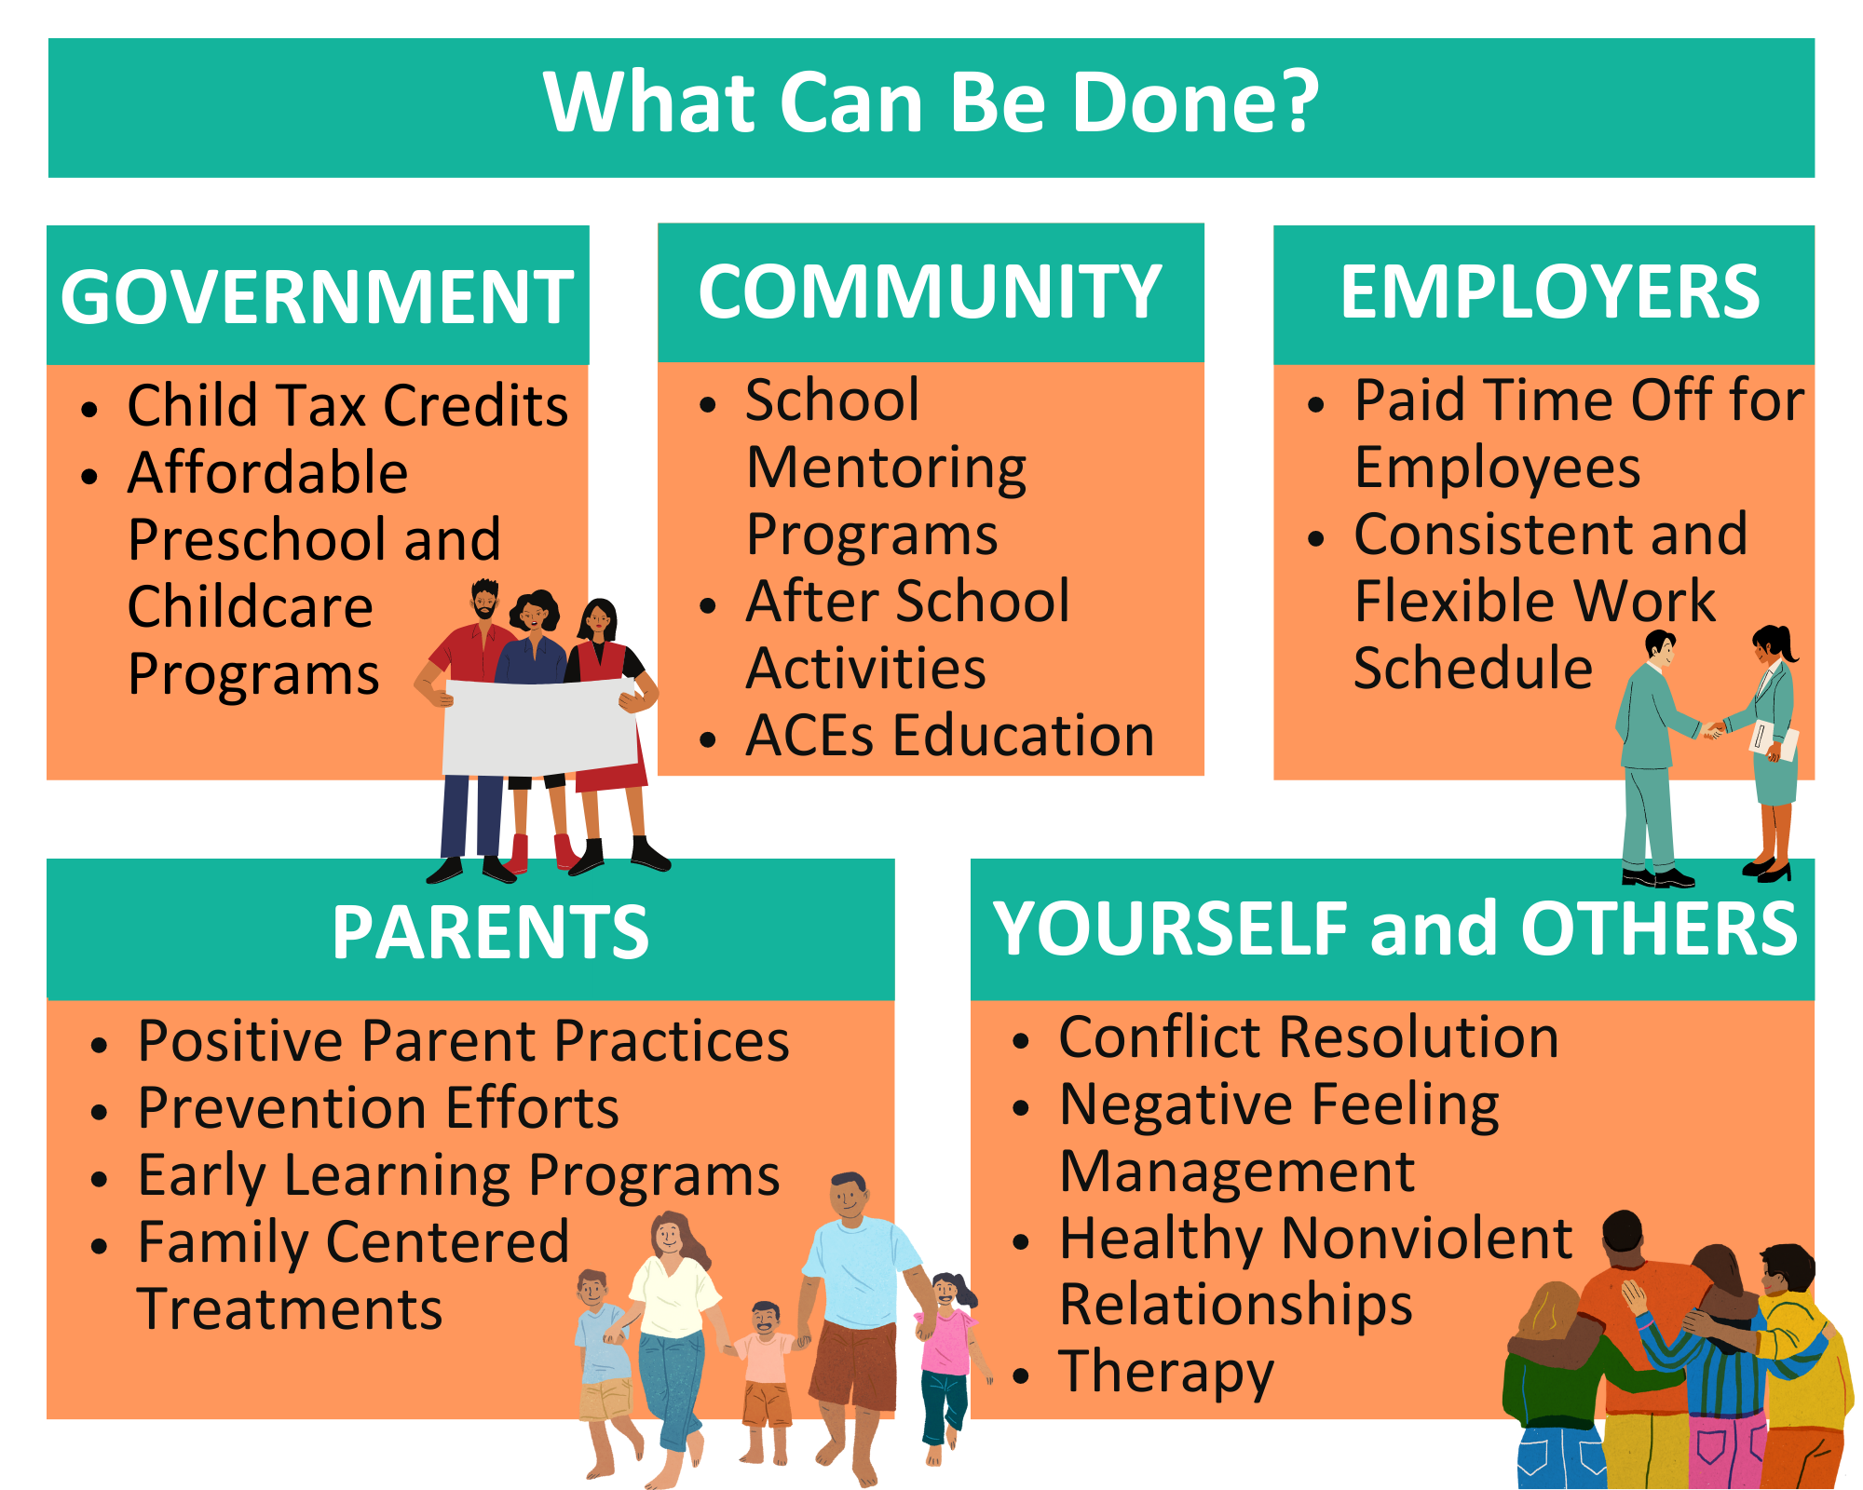
Information Credit: Centers for Disease Control and Prevention Teen Newsletter
https://www.cdc.gov/museum/education/newsletter/2023/mar/index.html
Notes:
Talking Points:
This is how we amplify resilience as a community on different levels
You are equipped with the knowledge of empathy, resilience, and trauma-informed care to work towards the goal in the center
Do you see your role in creating a resilient and trauma-informed community?
I hope you are leaving this session with that sense of hope that we talked about, and that you feel empowered to take action.
Script:
If we think about a whole community working together in a mutually-supportive way, we can see how all the individual roles fit together at multiple levels. We may all play different roles in a community, but if we are all attempting to build resilience in the people we have around us, whether professionally or personally, as a collective effort, we can amplify those ripples we talked about and have a bigger effect. This can range from small actions at home to large-scale policies.
This slide gives a sampling of how changes at many layers of a community can buffer and support its residents. [Review some of slide contents.]

Slide 25
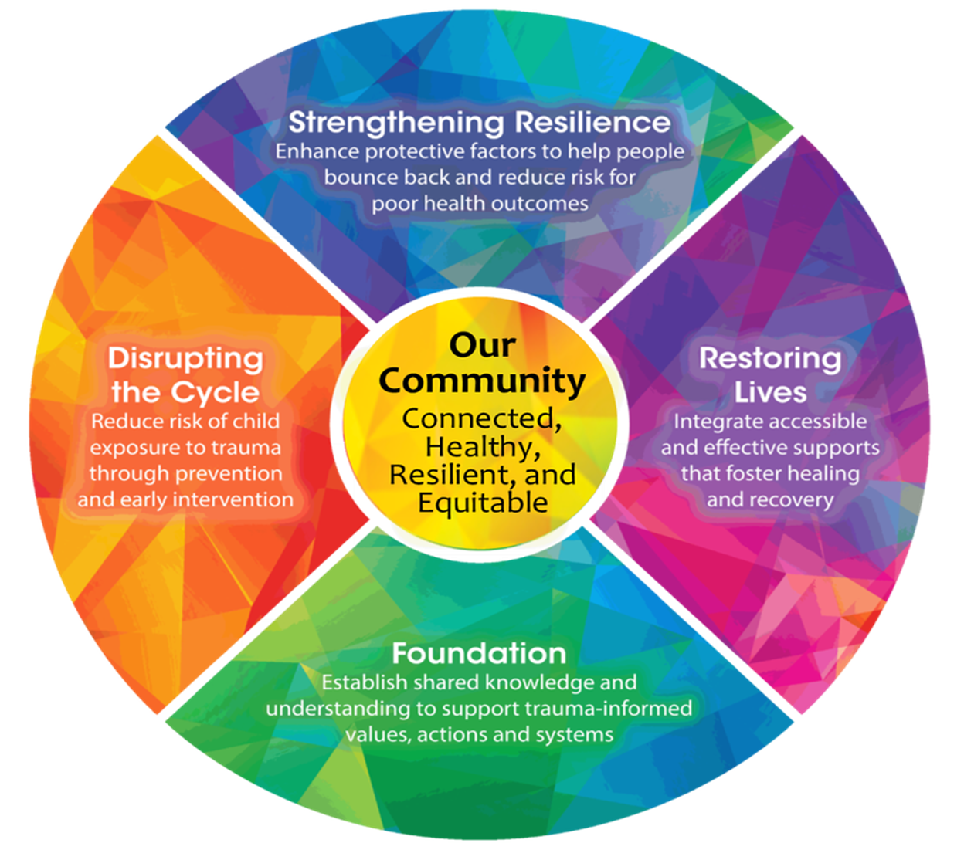
Notes:
Talking Points: [Handout #2]
The Kaleidoscope Model of Change is a framework that connects the work of the community
Goal is in the center
Four segments surrounding it are our Commitments to the community
Begins at the bottom with building a Foundation – common language and understanding
Other three Commitments represent where work is being done in the community
Circular because it is a continuous cycle that repeats itself
You are now equipped with some awareness of empathy, resilience, and trauma-informed care
We hope you are leaving this session with a sense of hope that we talked about, and that you feel empowered to take action
Script:
Give out Handout #2 – RTIC Overview
In the film, Laura Porter from Washington state said that if we can get information about ACEs flowing through communities, people will create very wise actions.
We have a community that is rich with resources, and many people have been doing a lot of work here to become more trauma-informed for about 15 years. The need to focus on this as a community is what brought together a group of people representing several different community efforts who wanted to learn more from each other about how their work interconnected and how they could be more trauma-informed. Together, they felt the film we just watched could be used to broaden the conversation around childhood trauma and resilience in our community and inspire more connection around this work.
This group, which grew into the RTIC Support Team, saw the wide variety of projects and organizations addressing resilience and trauma and felt there was a need for a framework that could help guide how we all work together to Create a Resilient and Trauma Informed Community (RTIC). We call this the Kaleidoscope Model of Change. The reason for the name is that everyone who picks up a kaleidoscope sees something different every time, though the contents stay the same. Addressing trauma as a community is similar in that how we address it will be unique to each person and organization.
At the center of the framework is our goal: a community that is connected, healthy, resilient, and equitable. Around that goal are four Commitments that this framework makes to the community.
What you just completed is the first step which is to build a foundation. That’s why this session is called Foundation training. Here, we are creating shared knowledge and a common language around Adverse Childhood Experiences, trauma-informed care, and building resilience. We’ve trained close to 2000 people in our Foundation-building sessions.
The next three commitments represent the work that is being done in the community, and where more work could be done. Many organizations and projects in this community are engaged in Disrupting the Cycle of trauma, Strengthening Resilience by enhancing protective factors, and Restoring Lives by providing support for those who are healing. You may work in one or more of these three areas, but together, if we are all supportive of each other’s work toward a common goal, we believe we can get to the center.
One of the main points in the film is that ACEs are often at the root of dozens of health and well-being outcomes, and that ACEs are common in virtually all populations.
Think about all the work people in this community do to directly address conditions and disorders and health concerns that may be at least partially rooted in ACEs. How heavily does that work focus on the present situation and treating outcomes that may have resulted from ACEs? While that work needs to continue, think about what else we could be doing to address this one potential root cause of these health outcomes that may not be getting addressed?
If we look back at what we’ve talked about today, I hope you can see how you are now equipped with some awareness of empathy, resilience, and trauma-informed care. These tools can help guide you to reach the goal in the center as one person within a greater community, because you already possess the skills to do so. You now have an opportunity to practice your skills more deliberately.
Do you see your role in creating a resilient and trauma-informed community? Assignment: think about a specific action you might like to take, either as an individual in your own or someone else’s life, or an action you can be part of in your community. Write that down, and when we send you a survey after today, we will remind you that you set an action for yourself and see if you have taken steps towards it.
I hope you are leaving this session with that sense of hope that we talked about, and that you feel empowered to take action.

Slide 26
Resources for RTIC Organizations
Find your own ACE score: https://developingchild.harvard.edu/media-coverage/take-the-ace-quiz-and-learn-what-it-does-and-doesnt-mean/
RTIC website: www.resilientcommunitieswi.com
Foundation training schedule
Organizational Assessment
Better Together: www.bettertogetherlacrosse.org
Resilience skill sheets
Resilience film (streaming): $2 rent/$8 purchase on Vudu, Google Play Movies, Apple TV, YouTube
Other films:
Paper Tigers film (school case study): Vudu, Amazon
“Perspectacles” video, empathy in a high school setting
Notes:
Talking Points/Script:
**Walk through the website**
Here are some other resources online that you can access yourself.
Please talk with me about what other resources would be helpful, and I will help you access them.

Slide 27
Putting Shifts into Practice
Take notice of your use of empathy...and missed opportunities.
Take notice of changes to thoughts, feelings, and interactions.
Share stories of Trauma Informed Care.
Listen for and recognize shifts in others.
Notes:
Talking Points:
We’ve focused on shifting your perspective toward practicing empathy.
As you go forward, keep developing your practice, using these tips on the slide
We hope you’ve gained some new insights from today’s session

Slide 28
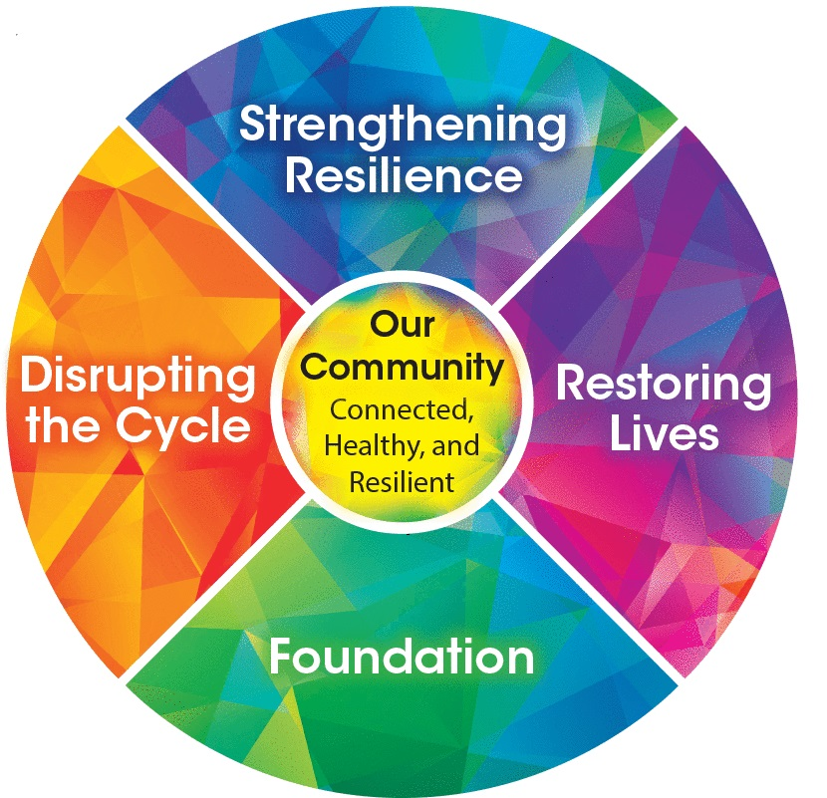
Resilience...
“…is not something you are born with...gets built over time.” (Dr. Jack Shonkoff)
Can be built at any stage of life
Creates protective factors that buffer toxic stress
Can stem from a single positive relationship
Is different for everyone
Notes:
Talking Points:
It’s easy to get caught up in the actual ACE score, and it’s important to understand that there is more to ACEs than the number.
The original ACE study grouped experiences into 10 categories—these are not the only ACEs
ACEs are only part of the picture of what impacts adult health—the diagram from the CDC shows other internal and external factors.
An ACE score simply accounts for whether the experience happened, not what its effect is.
Trauma is subjective—what is traumatic to one person may not be traumatic to others.
ACEs don’t have to be a lifelong risk factor or a source of shame because we can always build resilience.

Slide 29
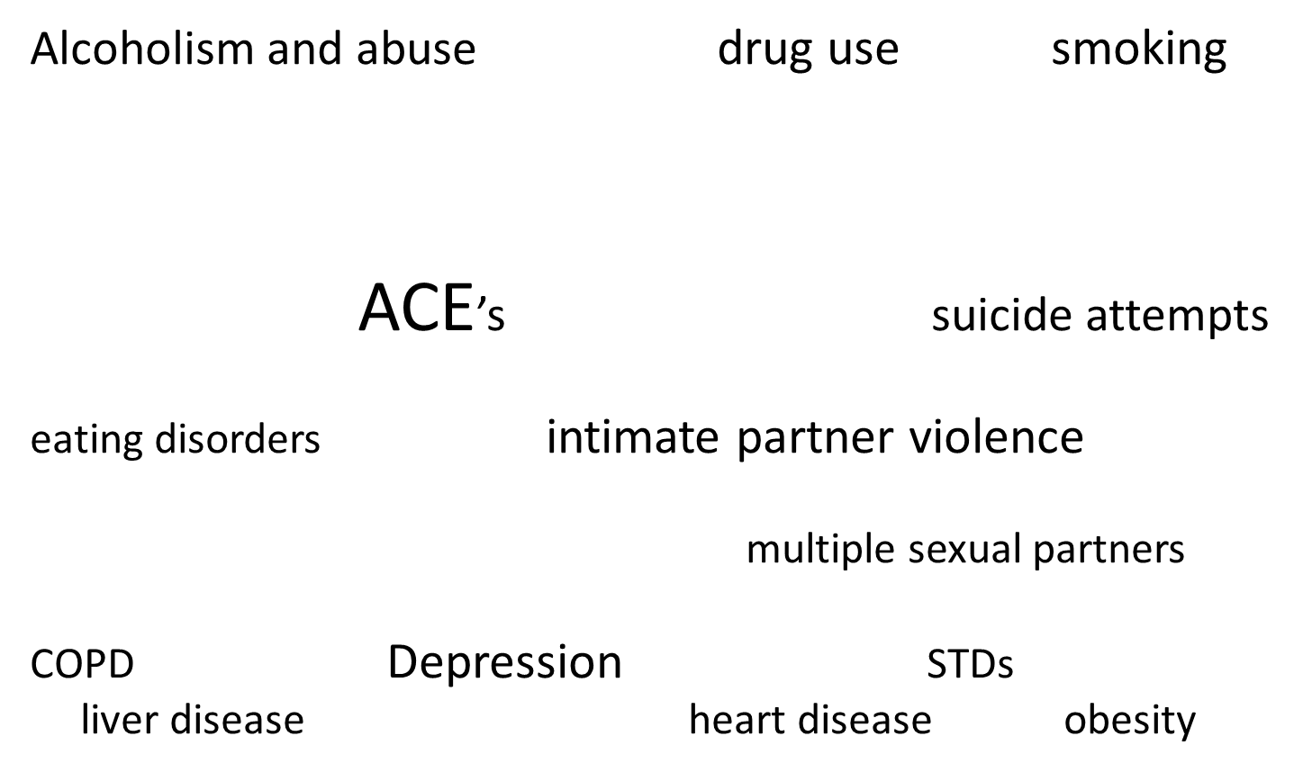
ACE findings. (CDC, 2014)
Notes:
Talking Points:
ACEs can be at the root of many common health and social issues shown here
ACEs are a strong predictor of future health issues
Our community is already doing much work in these areas
Imagine if everyone doing this work were united in working on ACEs as well

