Slide 1
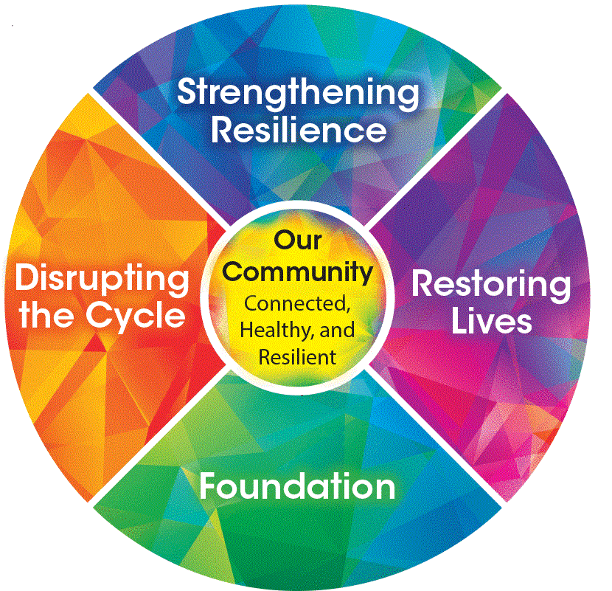
La Crosse County Vision Statements: “Building a more loving and connected community together by daring to change the way we care” [HS Leadership] “Putting the human back into Human Services” / “Be the One” [TIC Committee tagline]

Slide 2
Trauma Responsive Principles: (We will bring change by creating…) Safety (People feel physically and emotionally safe throughout the organization) Emotion Intelligence (understanding how and why people feel and act the way they do) Learning (It’s ok to try something new. It’s ok to make mistakes) Transparency (information honest, open, and flowing) Power Sharing/Collaboration Social Responsibility (balancing individual needs with those of the greater good) Growth/Change (things need to change, with change comes loss)

Slide 3
Trauma Responsive Principles: (We will bring change by creating…) Safety (People feel physically and emotionally safe throughout the organization) Wellness Groups Environment: changed employee breakroom, lobby, bathrooms, etc. Emotion Intelligence (understanding how and why people feel and act the way they do) Leadership/supervisors re-trained on reflective supervision Learning (It’s ok to try something new. It’s ok to make mistakes) Finding ways to say yes to individuals asking for help, instead of leaning on old practices Transparency (information honest, open, and flowing) Agency “Town Hall” Meetings Power Sharing/Collaboration ISRS partnership with local Police to form mental health/co-responder program Discussion and creation of a consumer survey to understand needs from consumer perspective. Social Responsibility (balancing individual needs with those of the greater good) Work from home Breaking down silos between sections (youth justice/child protective services/comprehensive community services/ etc.) Growth/Change (things need to change, with change comes loss) Investment in professional development related to racial justice and TIC Movement into the community to do our work: giving up our "safety net" of the office

Slide 4
Breakouts: Top 10 Challenges
Getting leadership on board
Coordination across large organizations, expanding to other programs
Policy review is an overwhelming task
Staff turnover and learning curves
Assessing, tracking, and communicating progress
Being all volunteer-driven
Getting stuck as to what to do next
Communicating about RTIC across the organization
Creating perspective shifts around trauma and resilience
Understanding my role in RTIC

